Slide 1
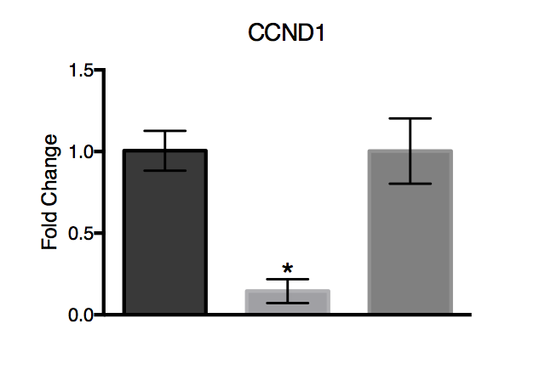
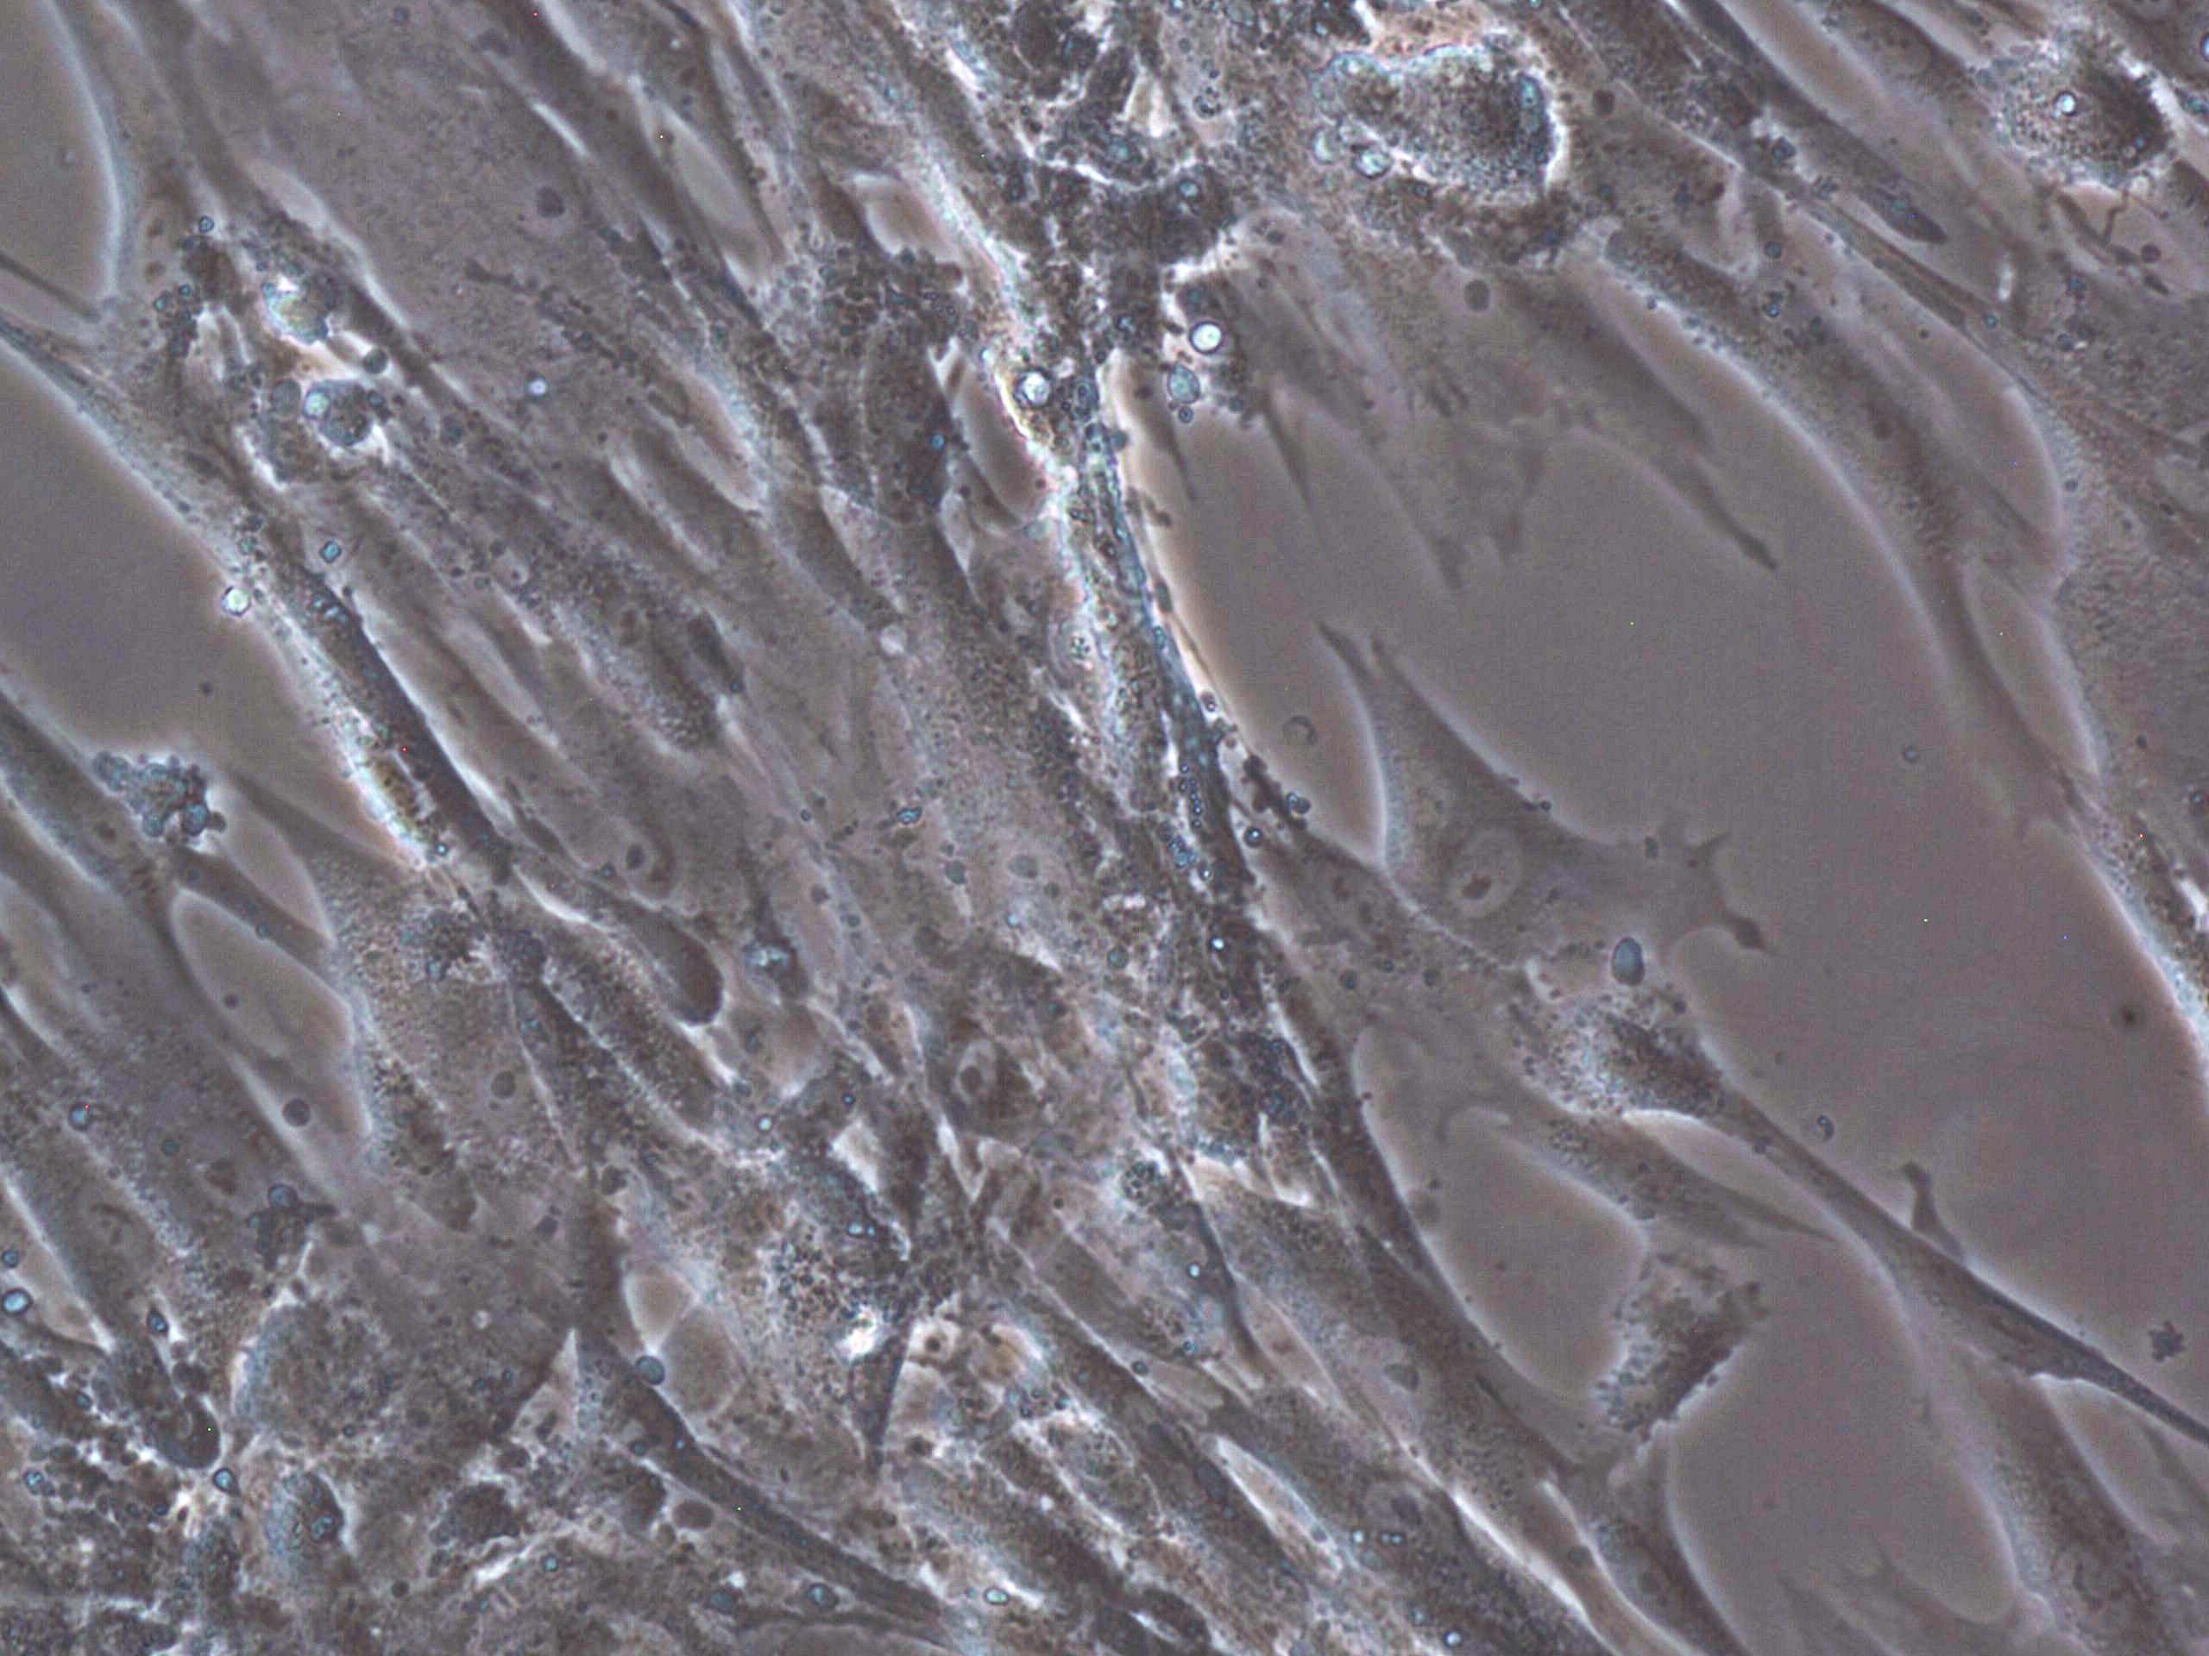
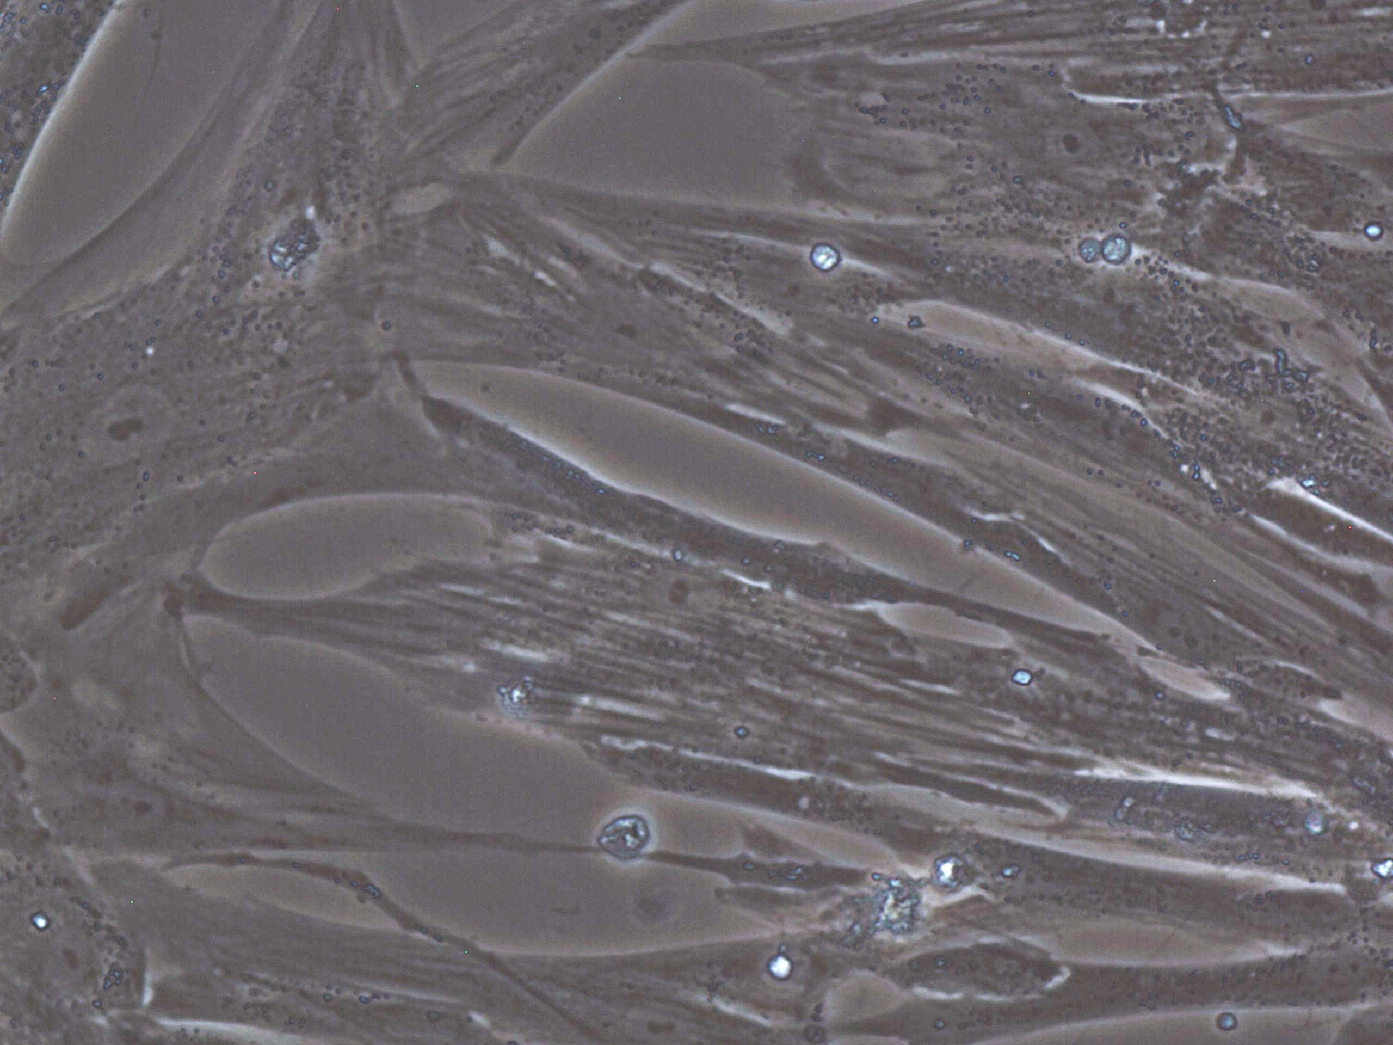
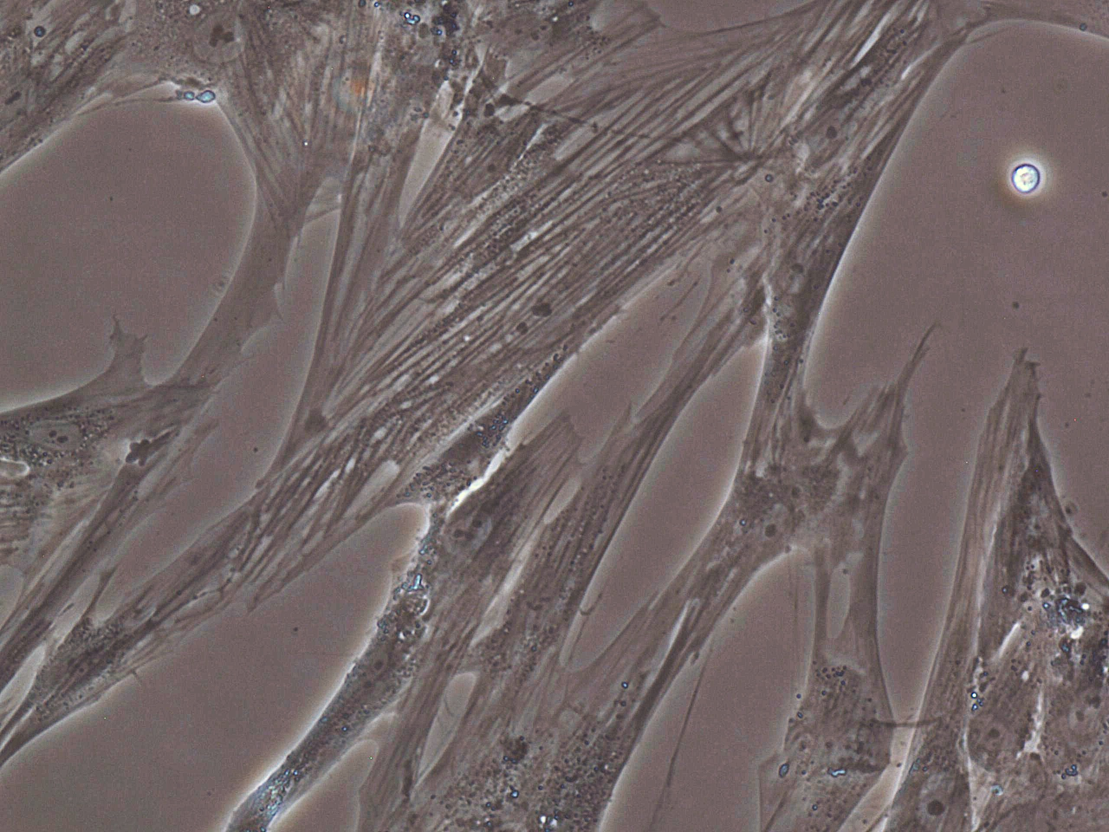
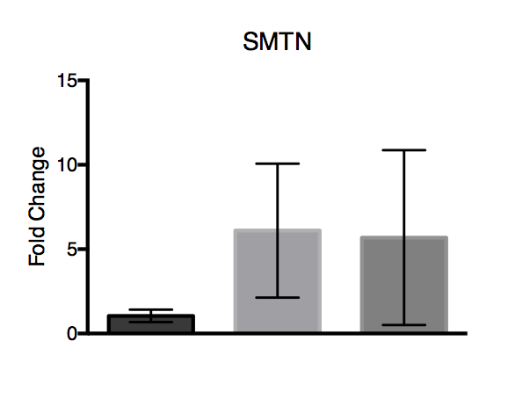
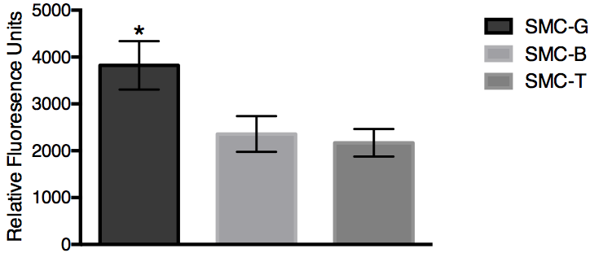
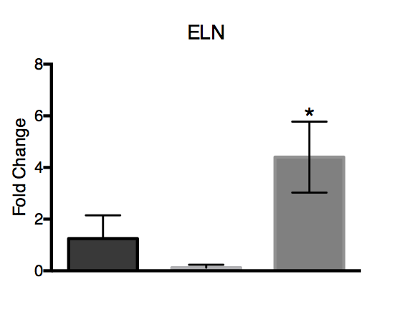
A)
SMC-T
SMC-G
SMC-B
B)
Figure 1. A) Bright field images of SMC-G, SMC-B, and SMC-T on culture day 4 at 20X magnification. B) Analysis of PrestoBlue assay, *p<0.05 one-way ANOVA
Notes:
20x BF
Rid lines/chartjunk
20x and RFU 1 fig, EDU images A and then graph B in fig2, protein exp fig 3, gene expression fig 4

Slide 2
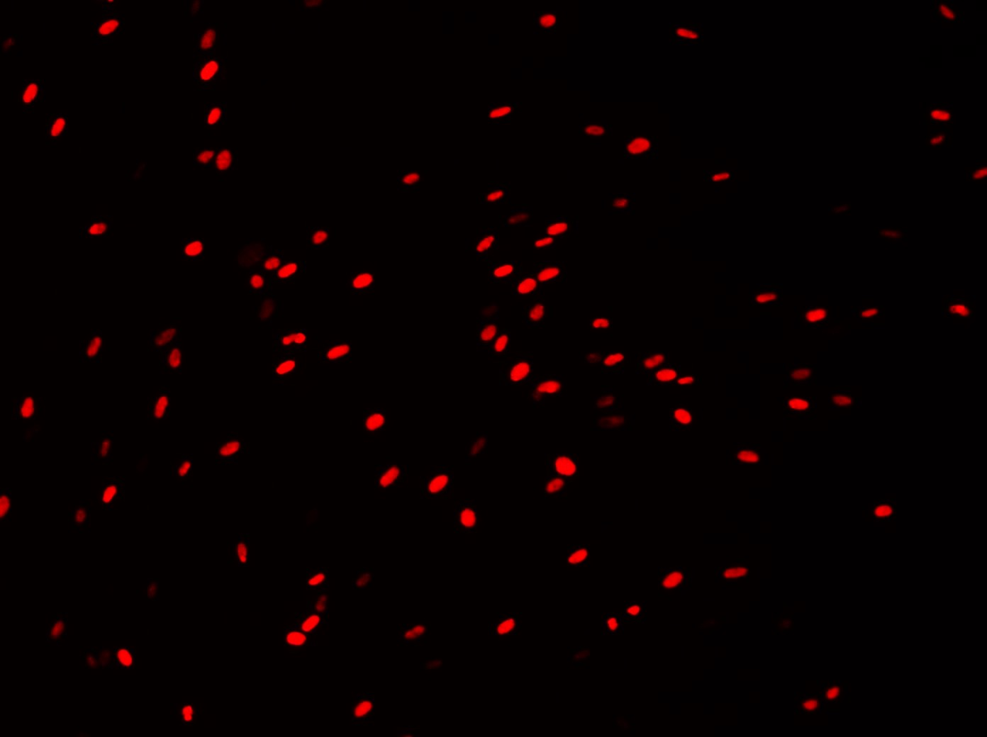
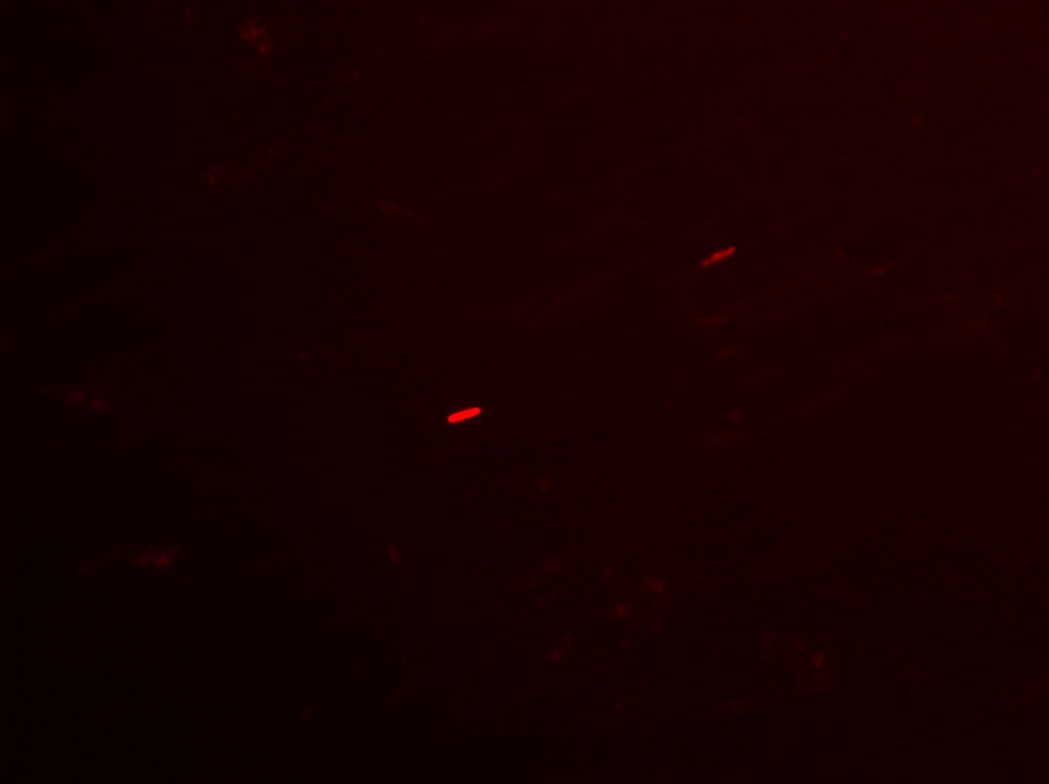
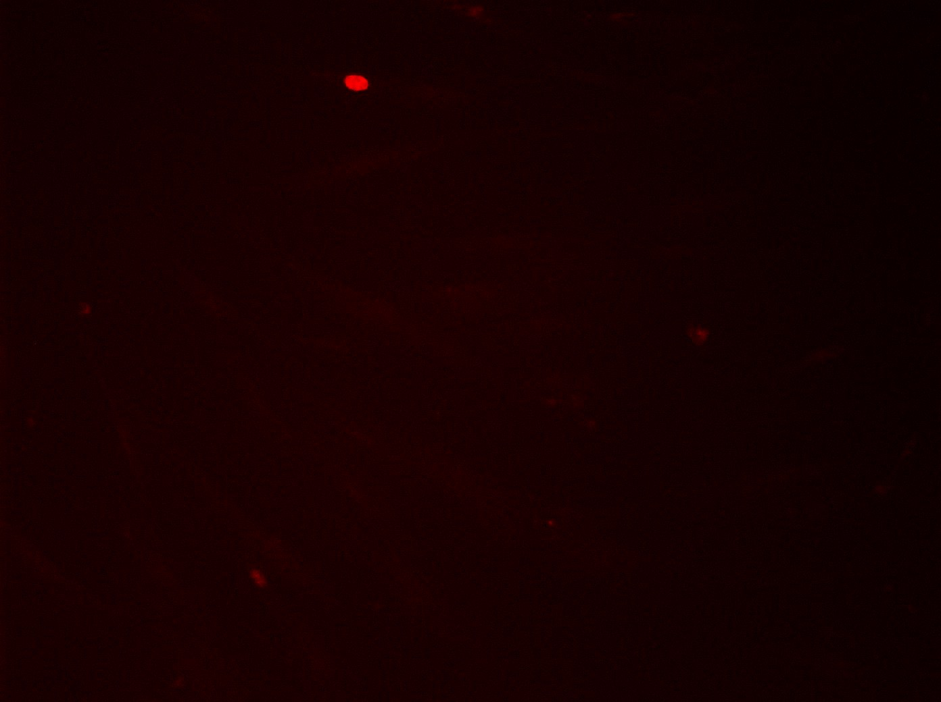
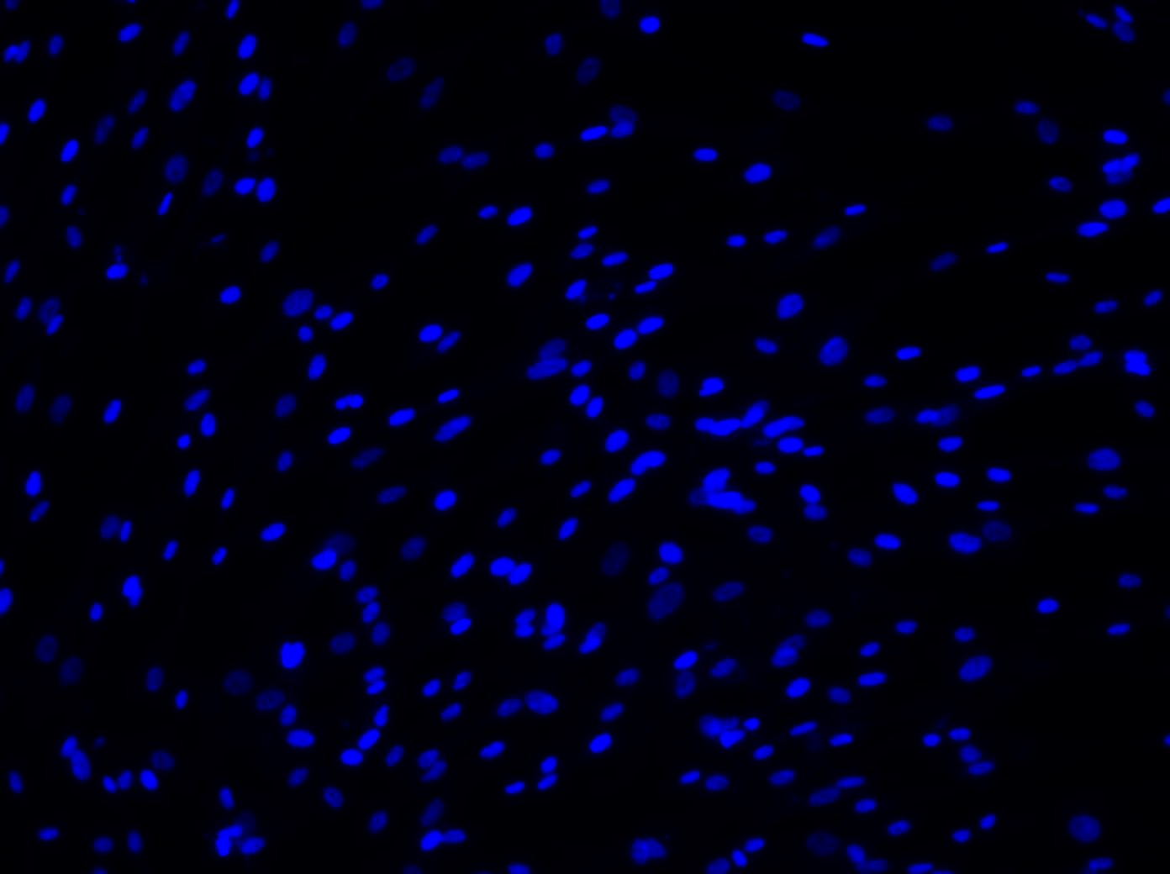
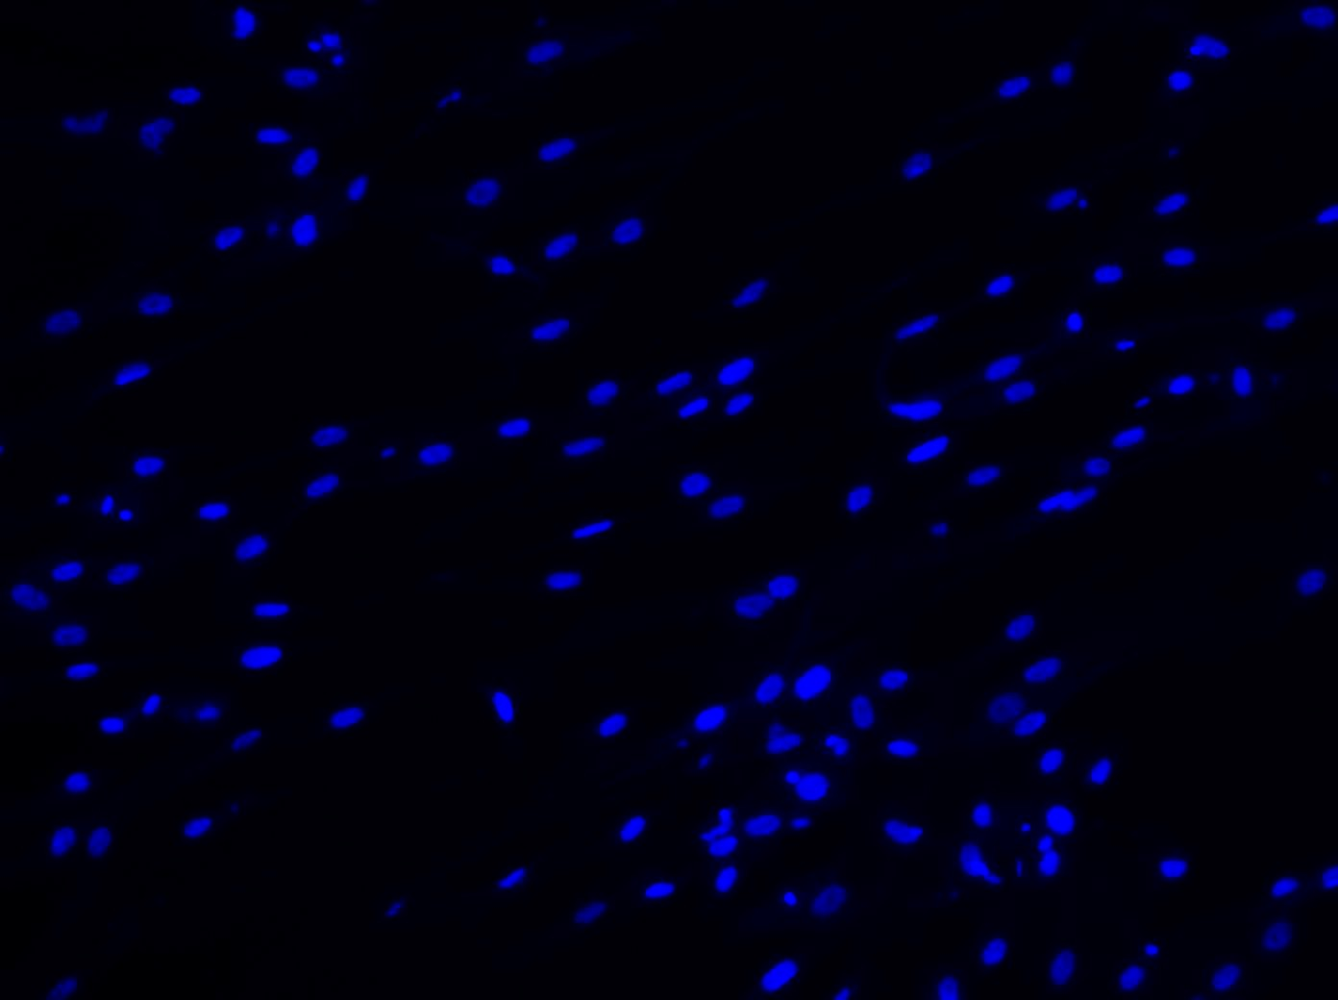
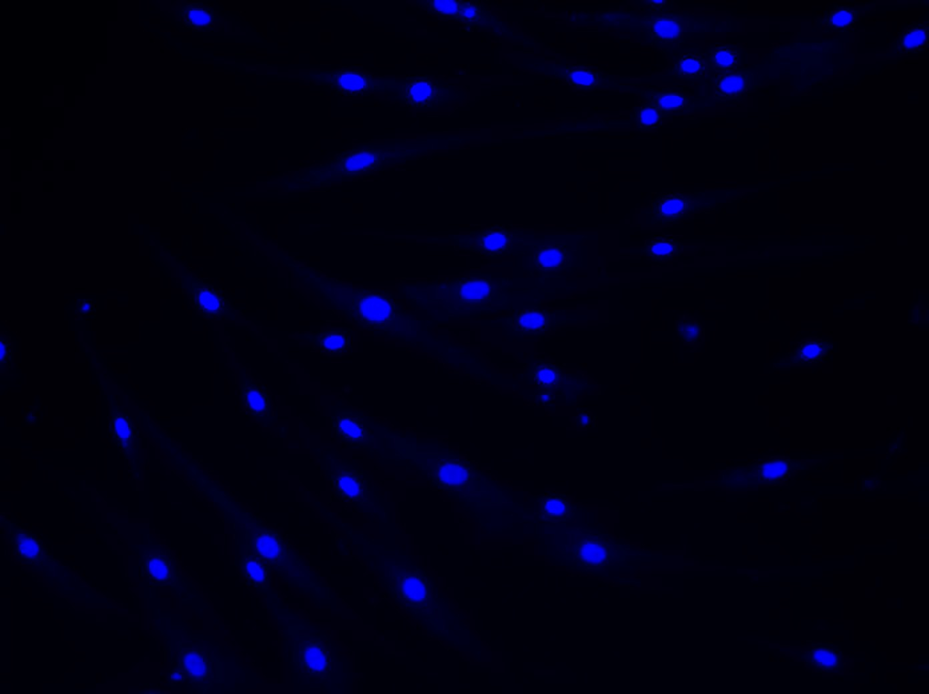
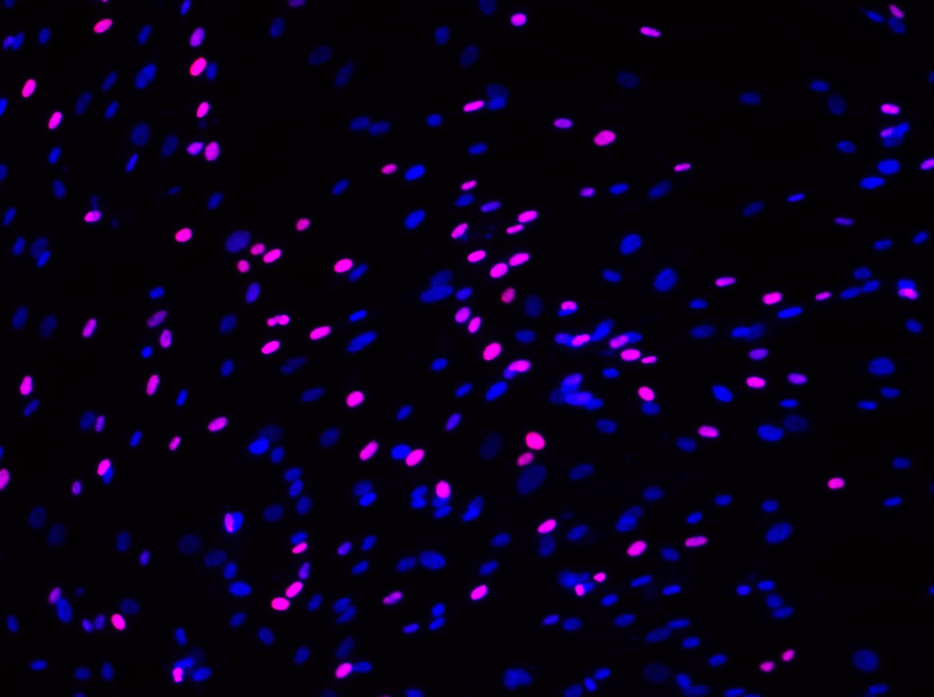
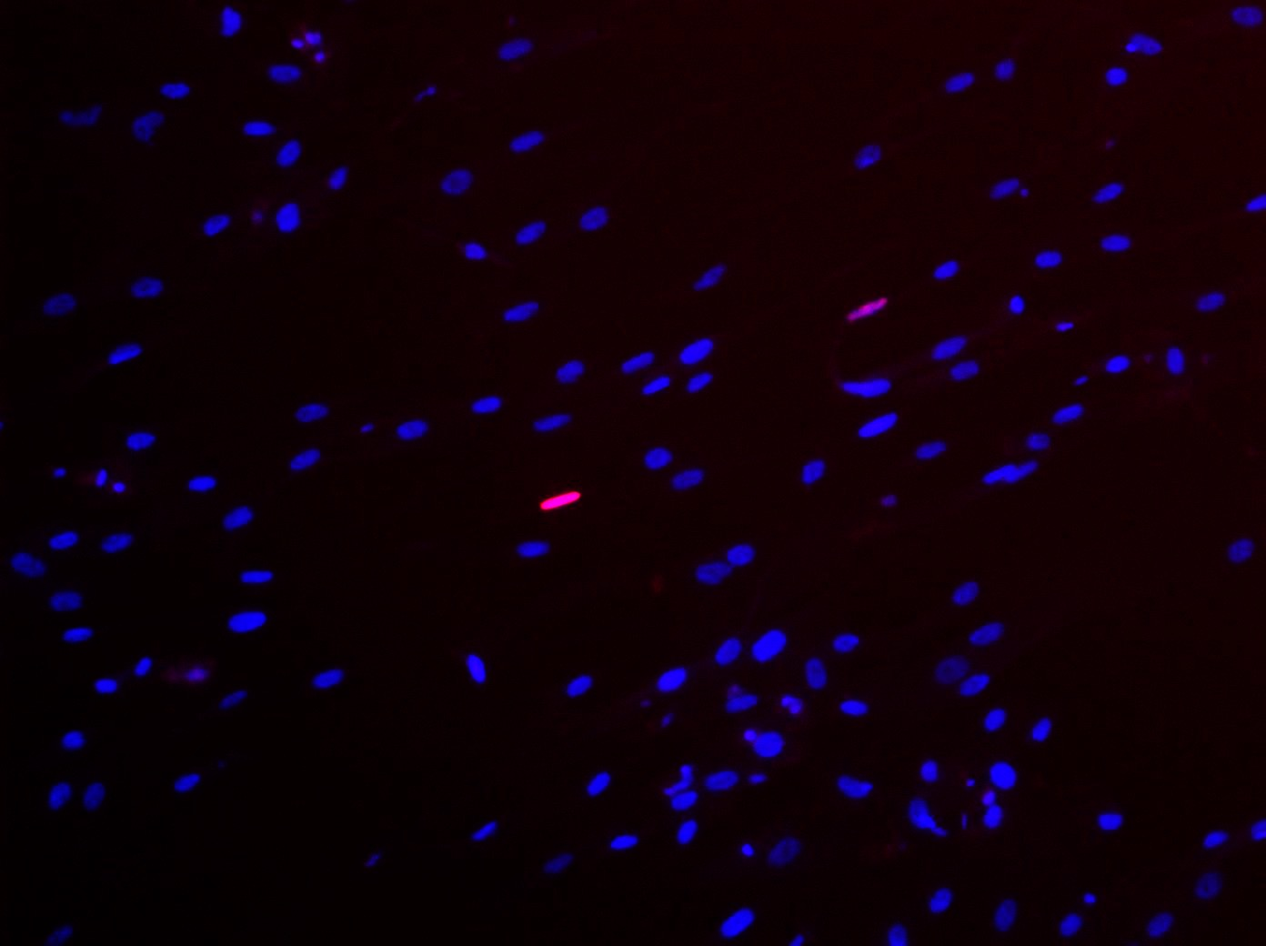
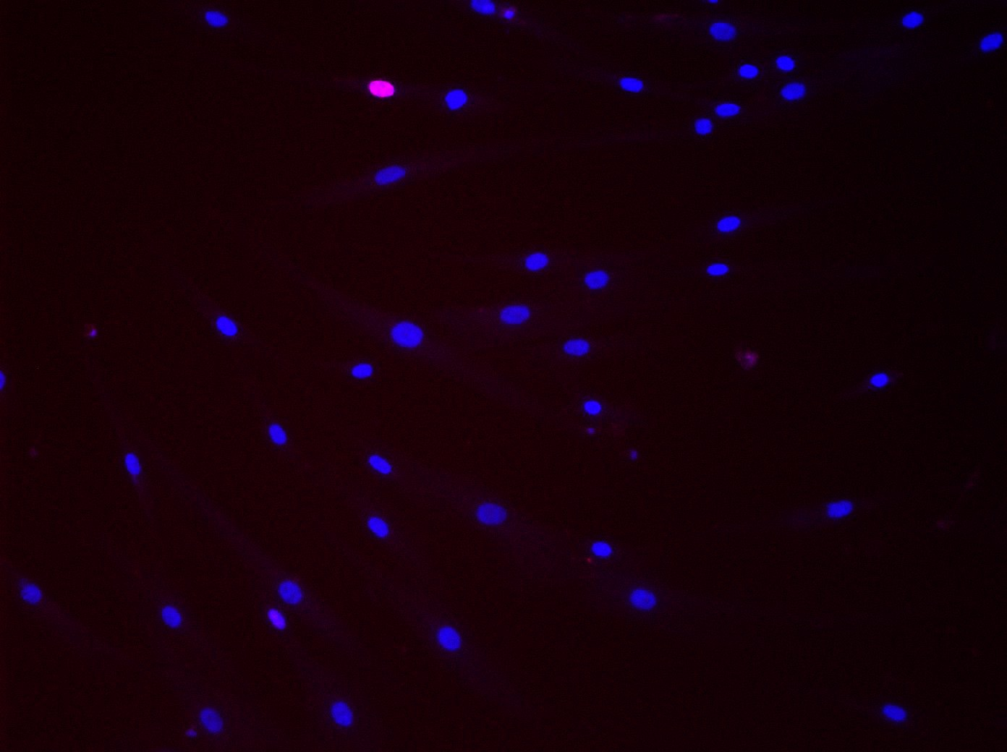
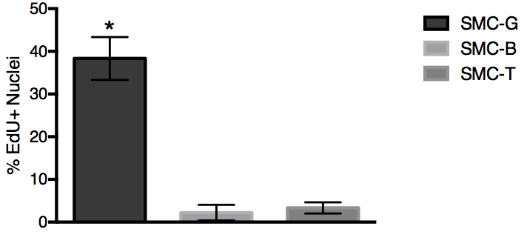
A)
SMC-T
SMC-G
SMC-B
B)
Figure 2. EdU assay of SMC-G, SMC-B, and SMC-T on culture day 4. A) Images taken at 10X magnification showing expression of EdU (top), DAPI (middle), and EdU and DAPI merged (bottom). B) Analysis of the percentage of EdU+ nuclei, *p<0.05 one-way ANOVA

Slide 3
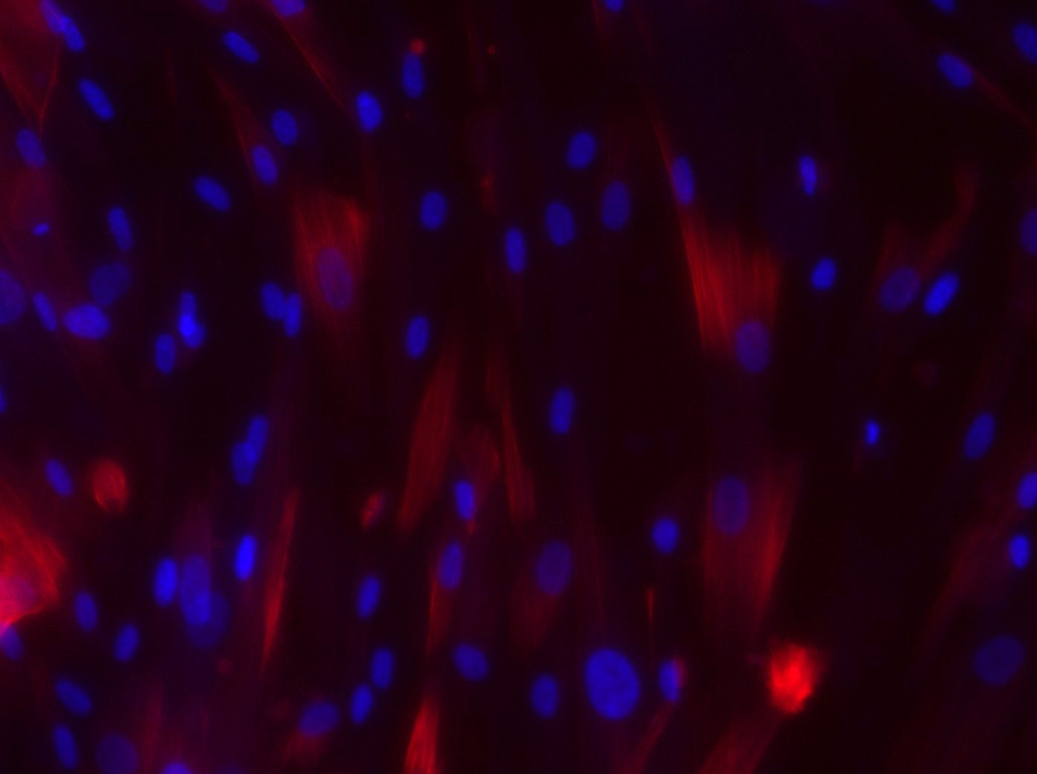
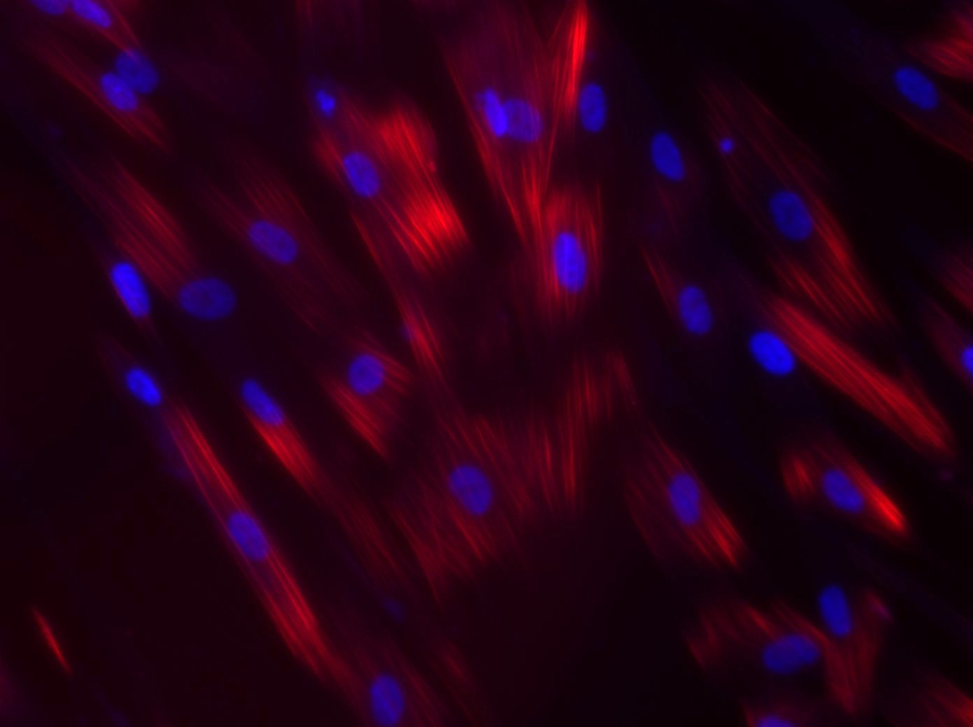
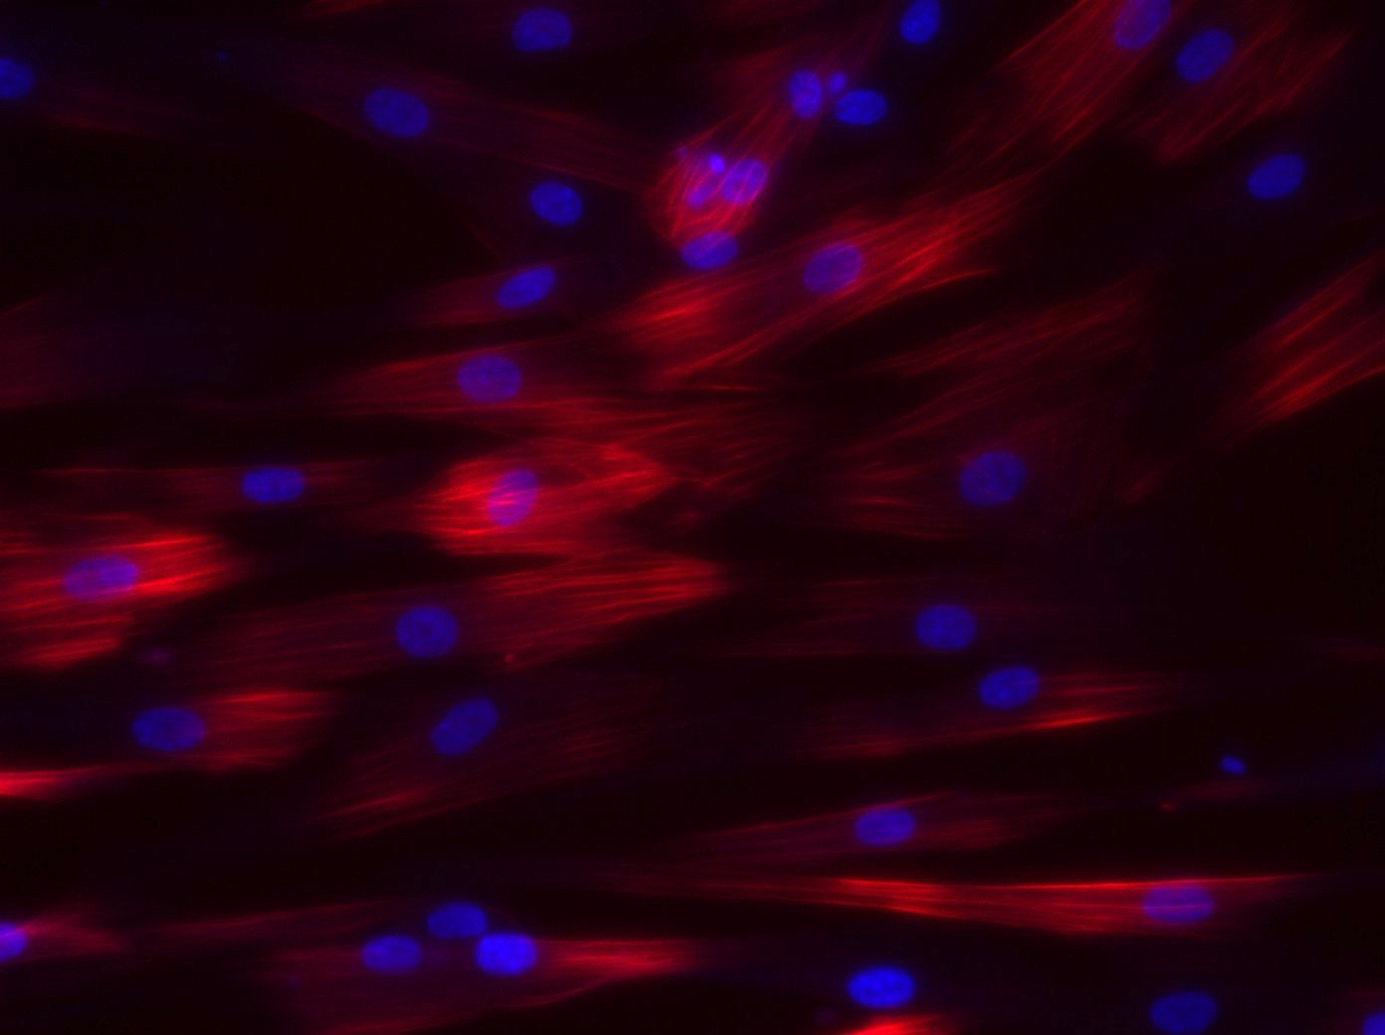
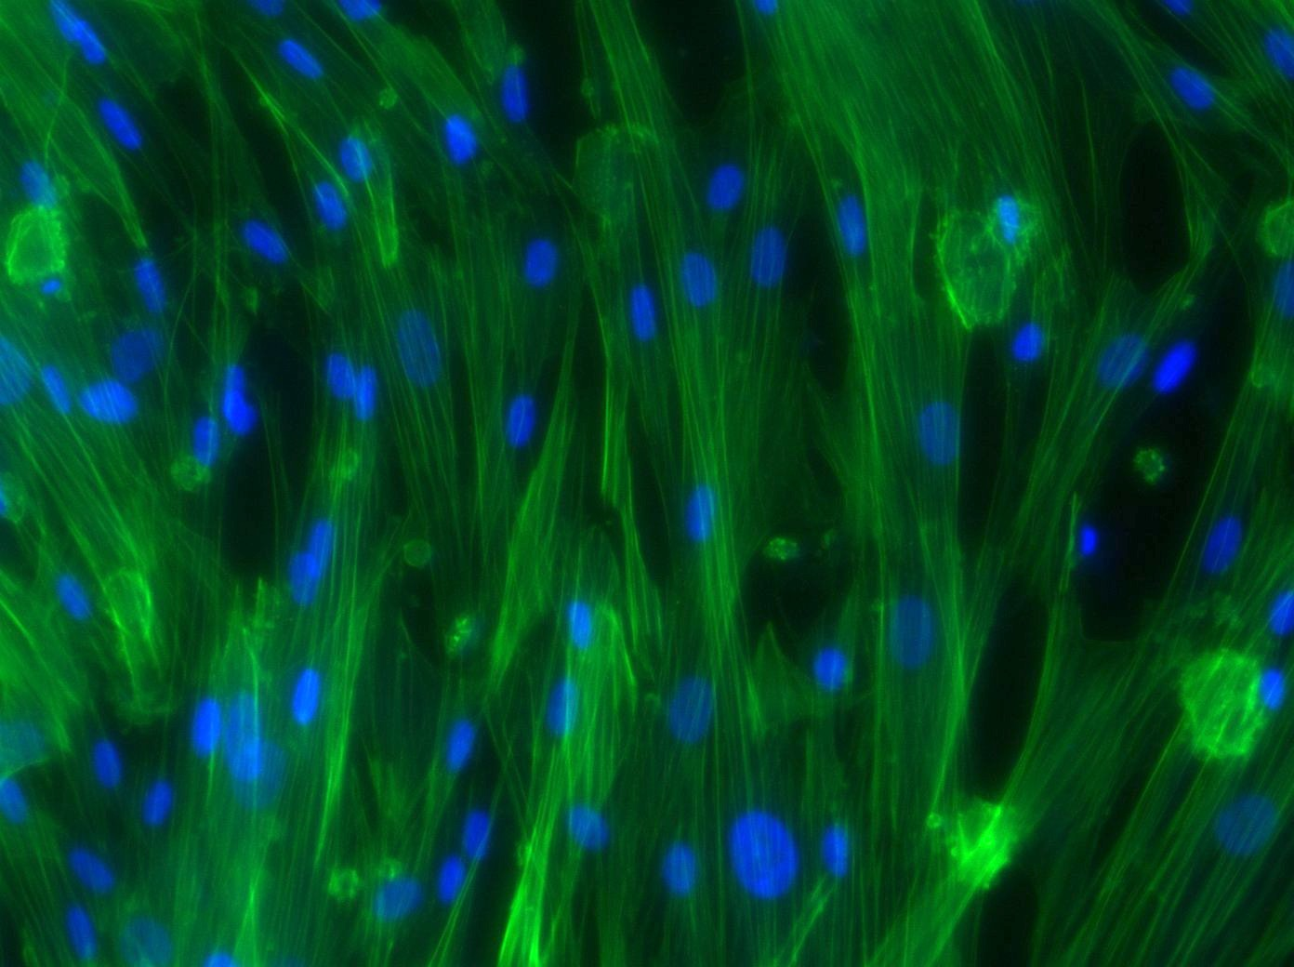
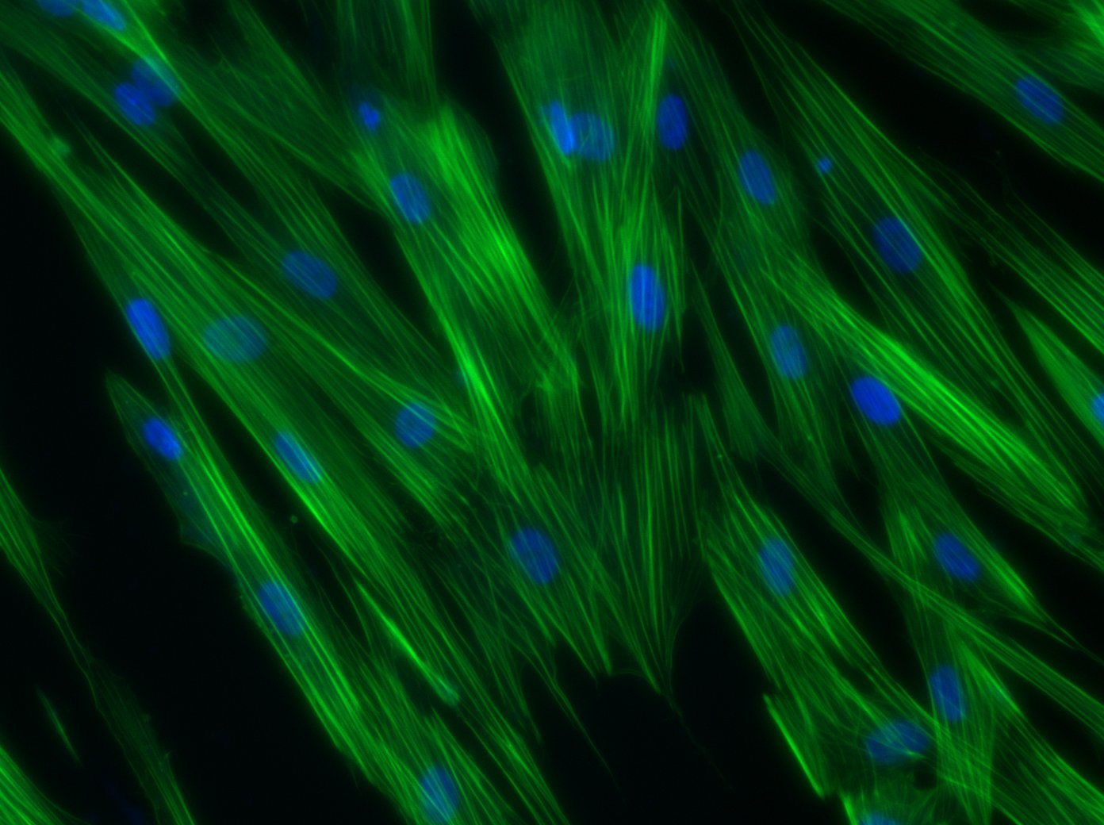
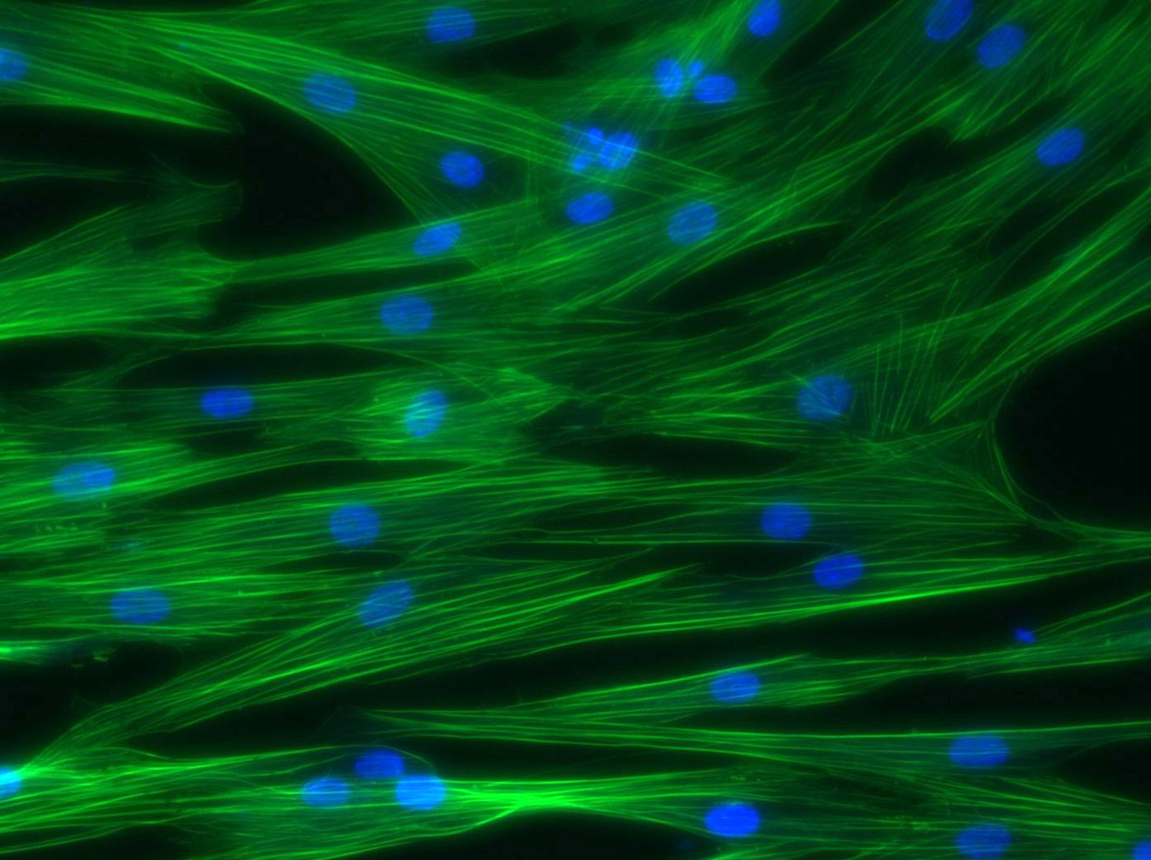
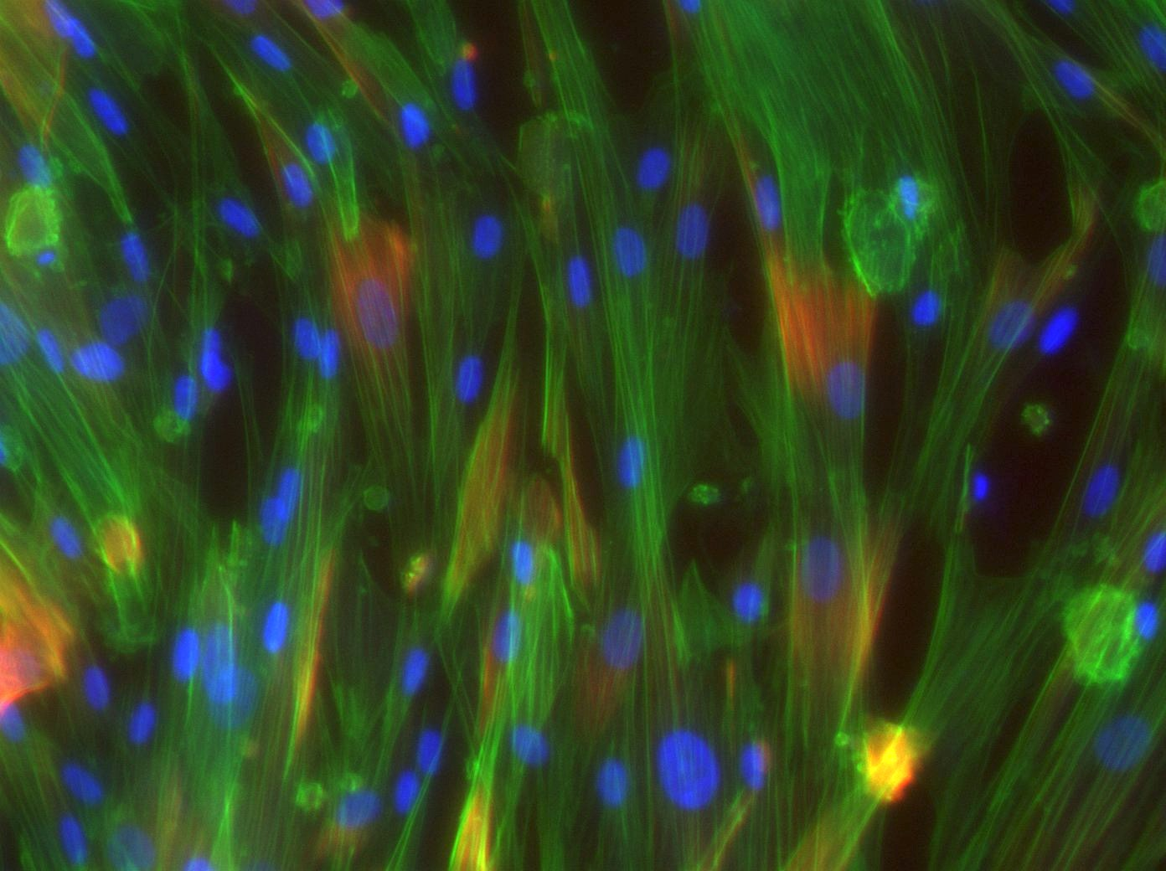
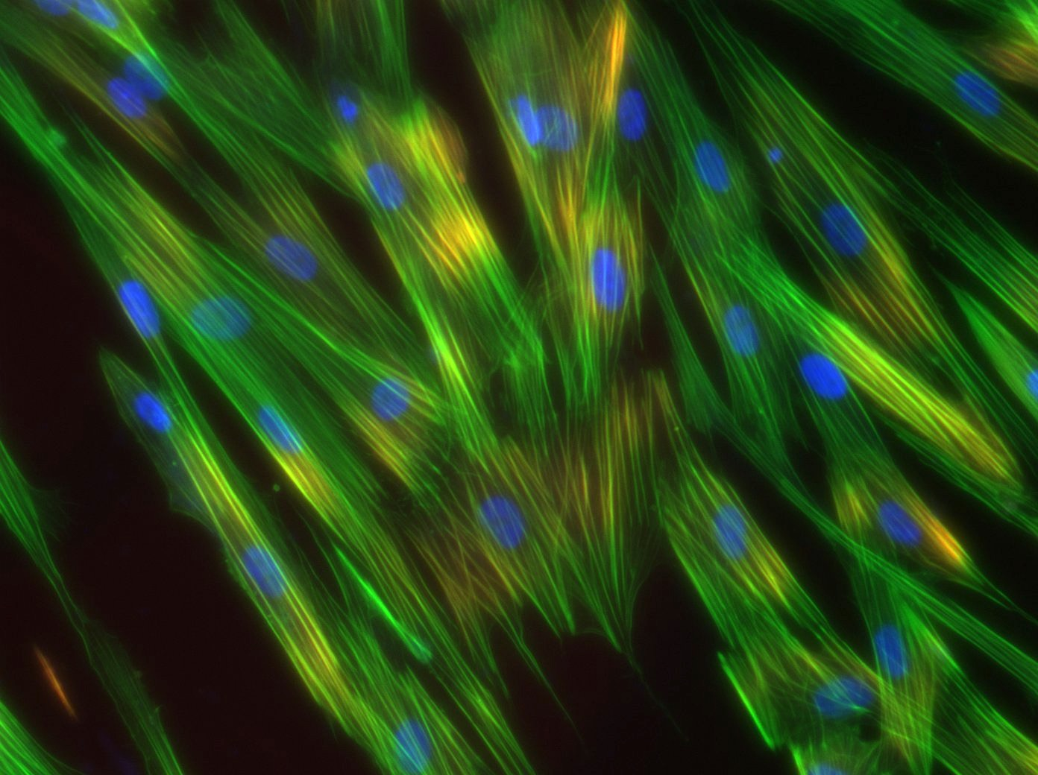
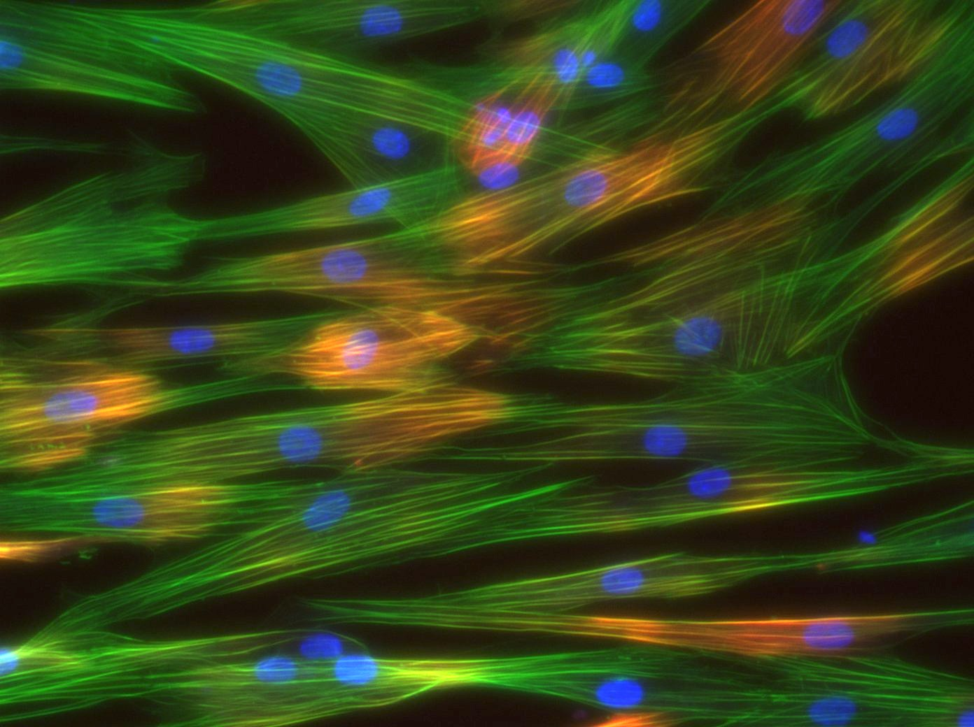
SMC-G
SMC-B
SMC-T
Figure 3. Cells were stained for calponin (red, top & bottom), phalloidin (green, middle & bottom), and DAPI (blue) and imaged at 20X magnification
Figure 4. Cells were stained for calponin (red, top & bottom), phalloidin (green, middle & bottom), and DAPI (blue) and imaged at 20X magnification

Slide 4
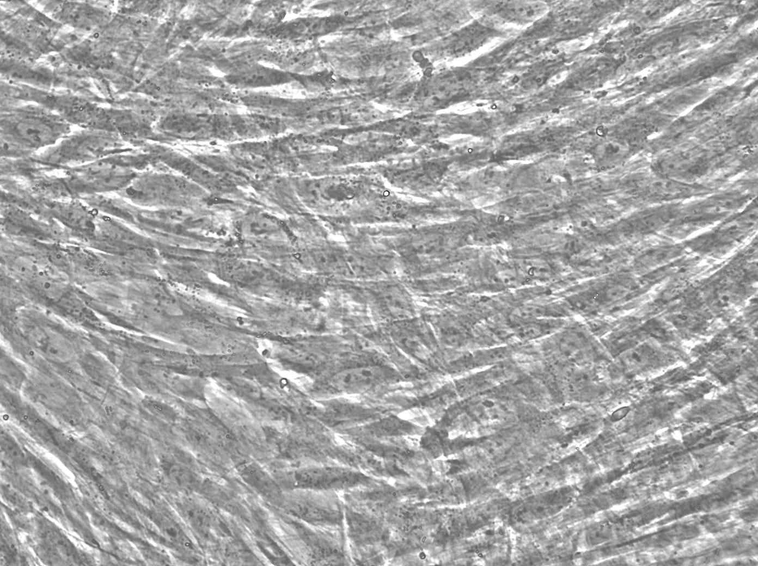
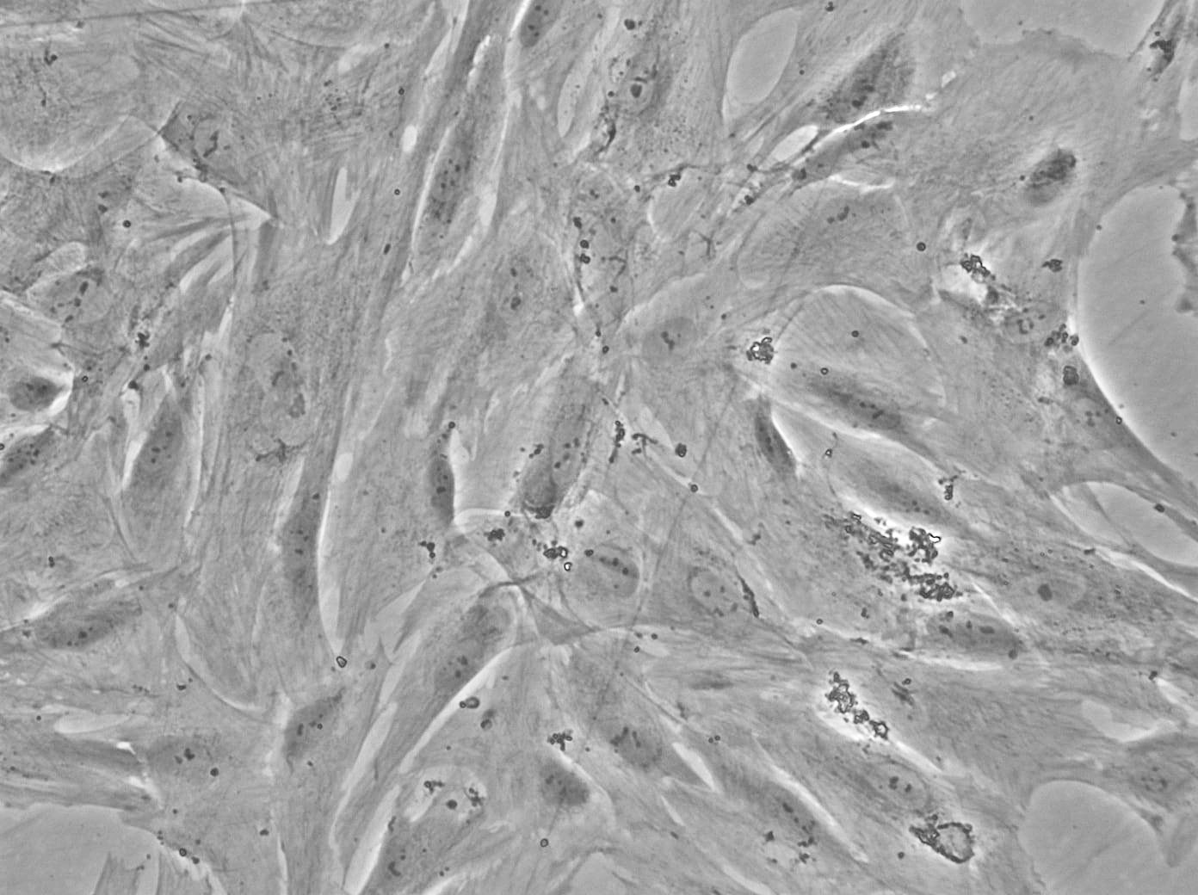
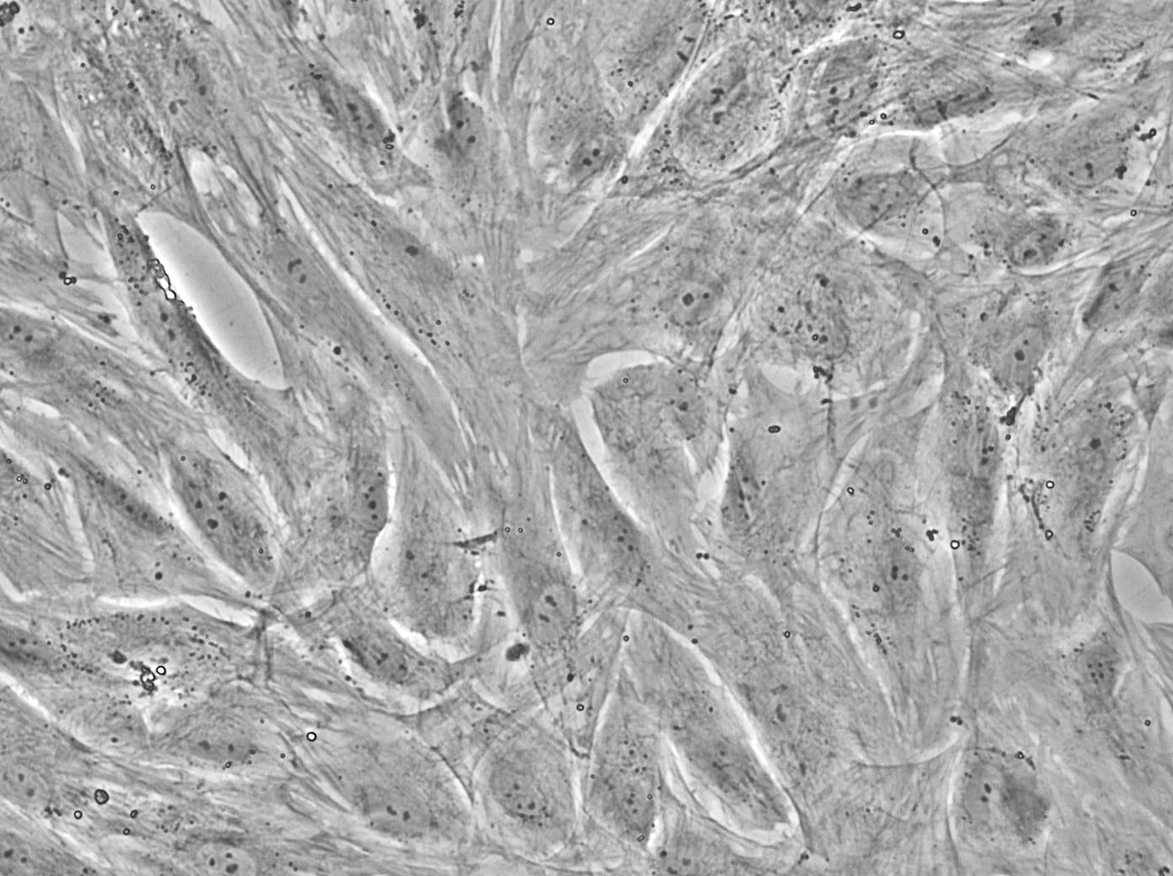
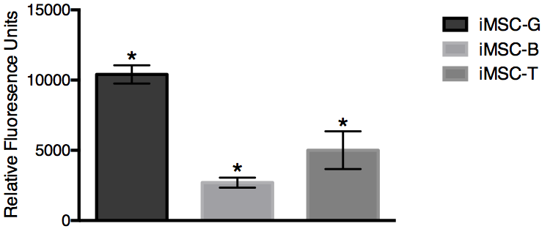
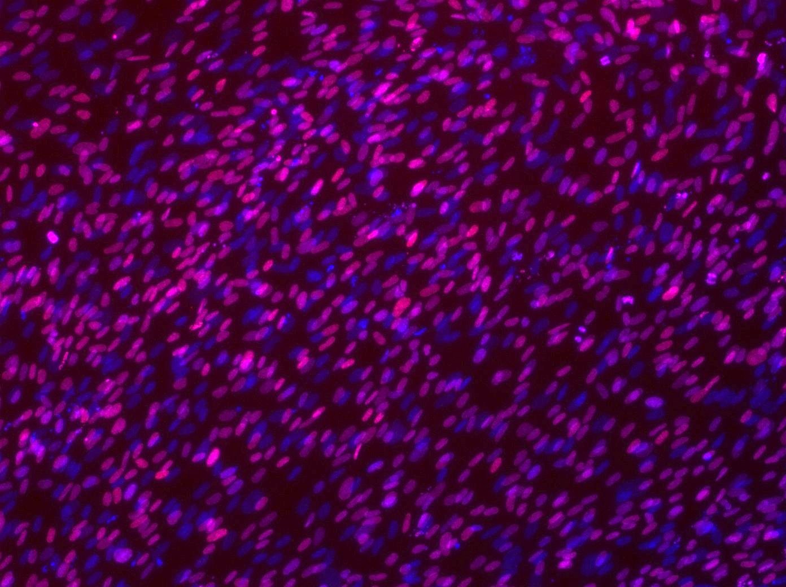
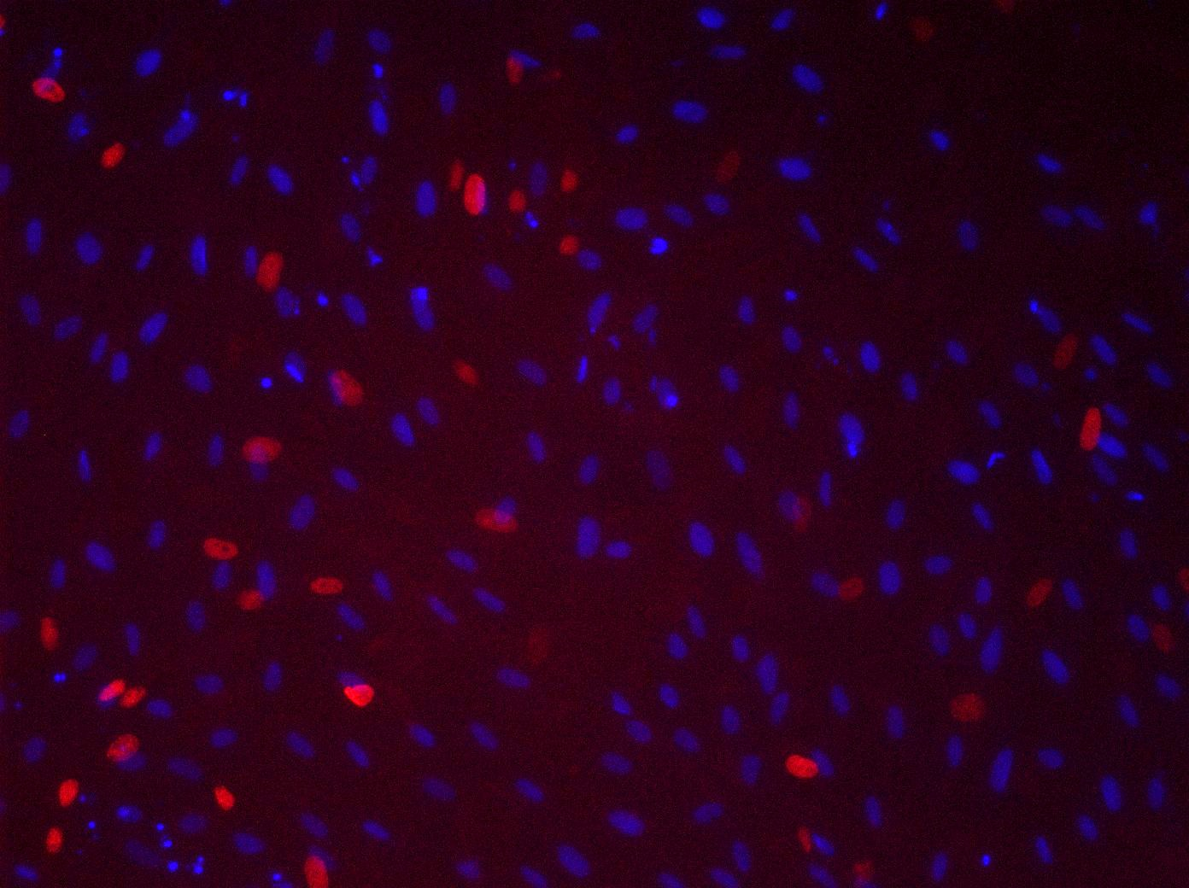
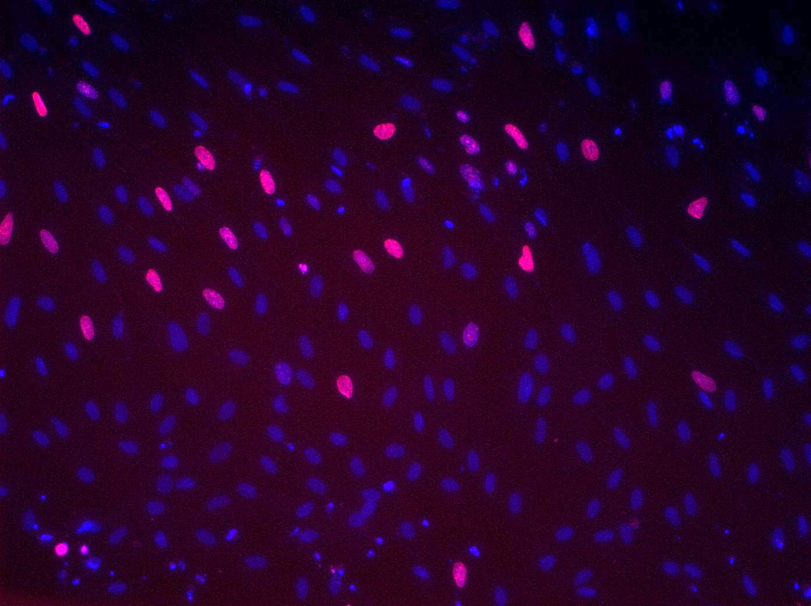
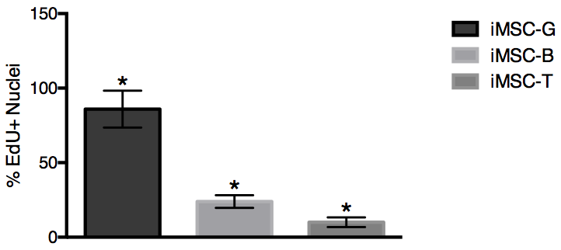
A
iMSC-T
iMSC-G
iMSC-B
B
Figure 5. Characterization of G, B, and T hUASMCs on day 4. A) Bright field images showing morphology at 4X magnification
A
iMSC-G
iMSC-T
iMSC-B
B
Figure 6. Characterization of G, B, and T hUASMCs on day 4. A) Bright field images showing morphology at 4X magnification
Notes:
20x BF
Rid lines/chartjunk
20x and RFU 1 fig, EDU images A and then graph B in fig2, protein exp fig 3, gene expression fig 4

Slide 5
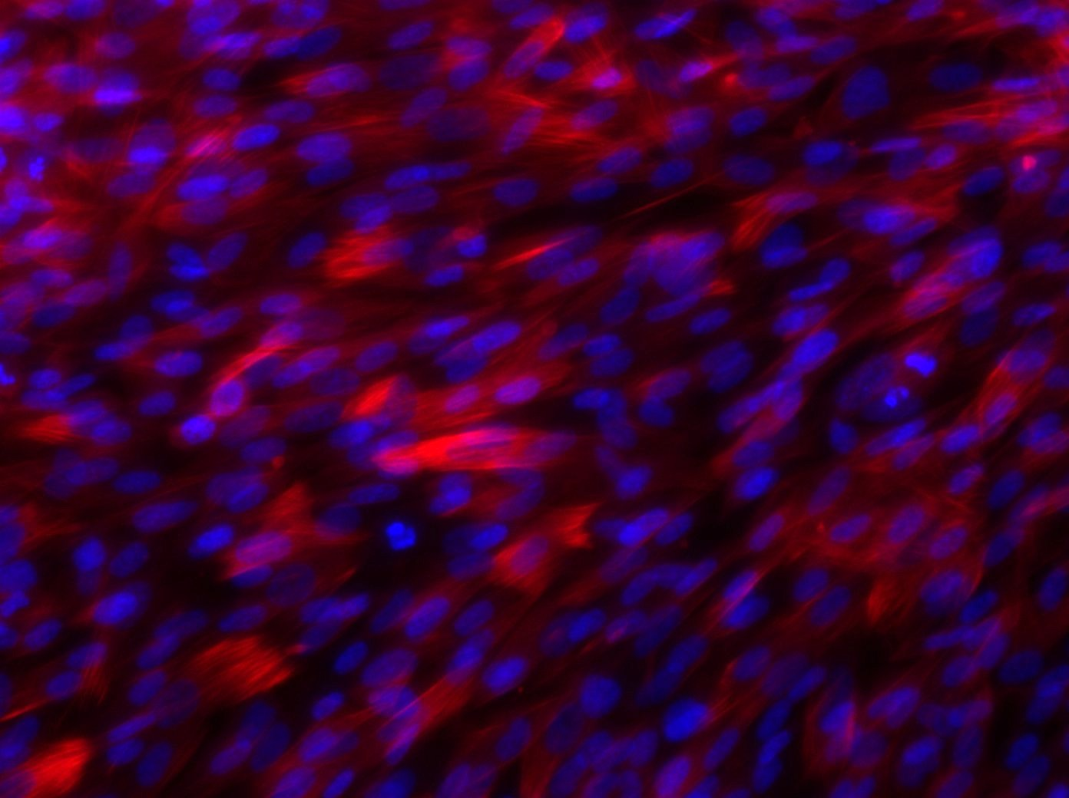
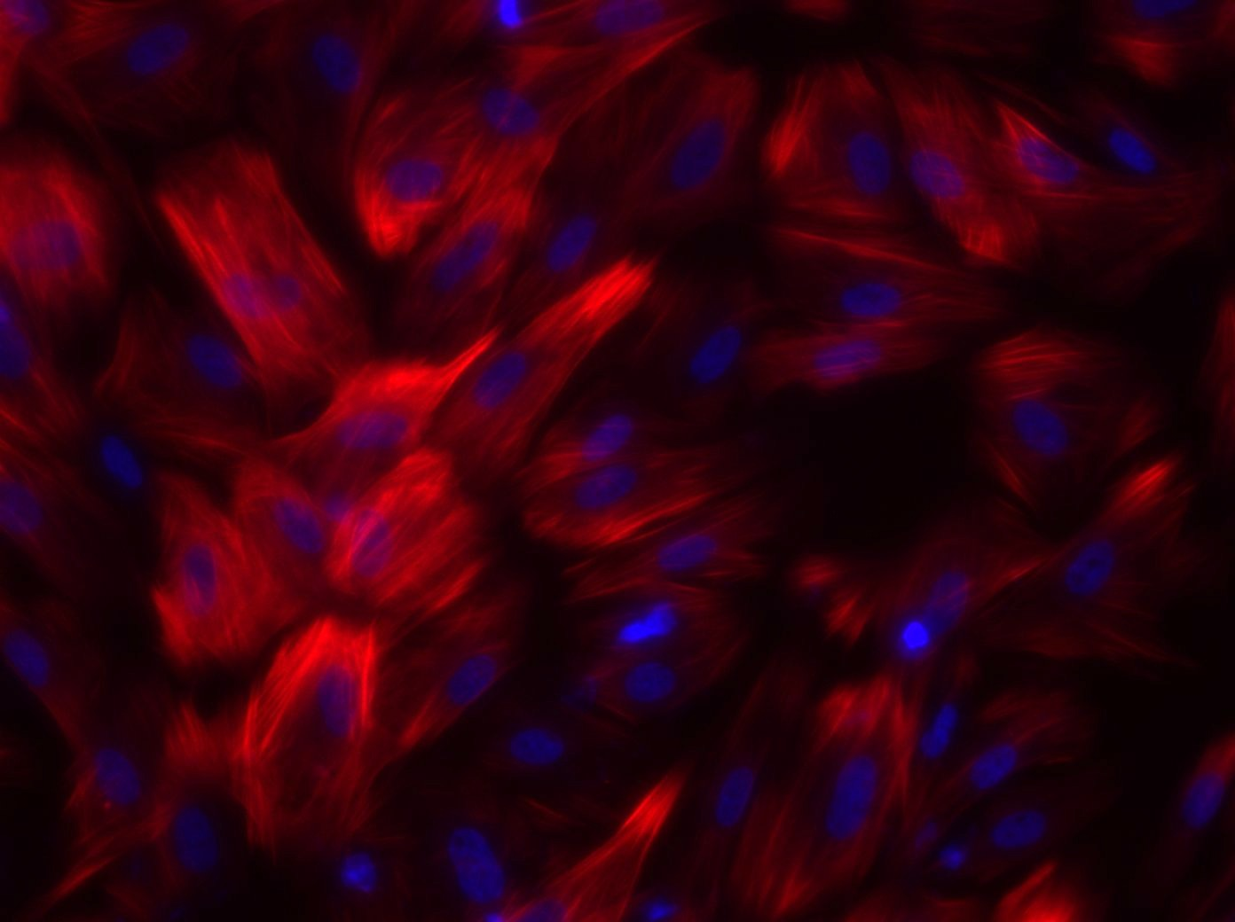
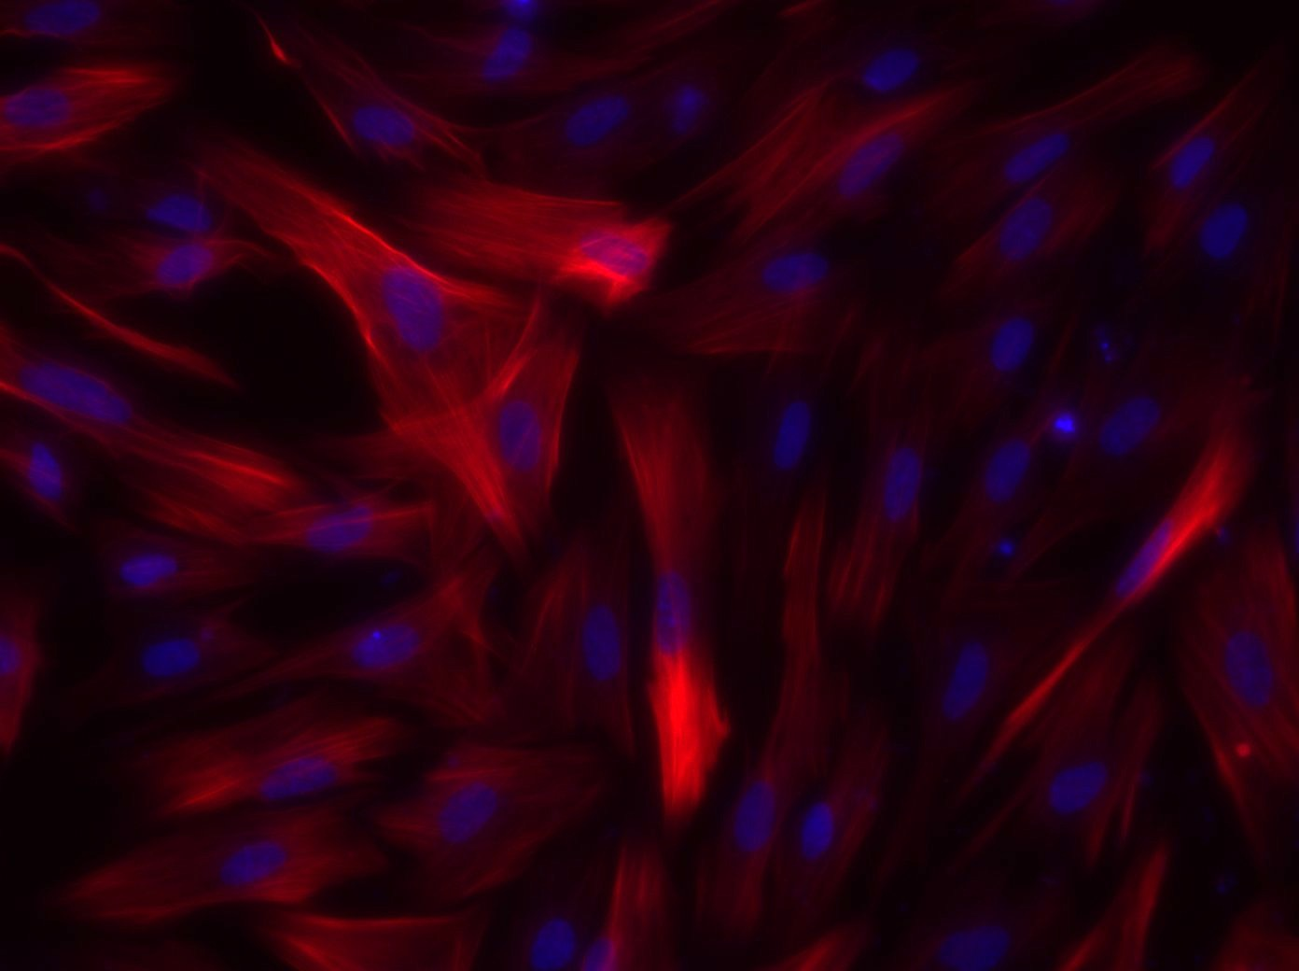
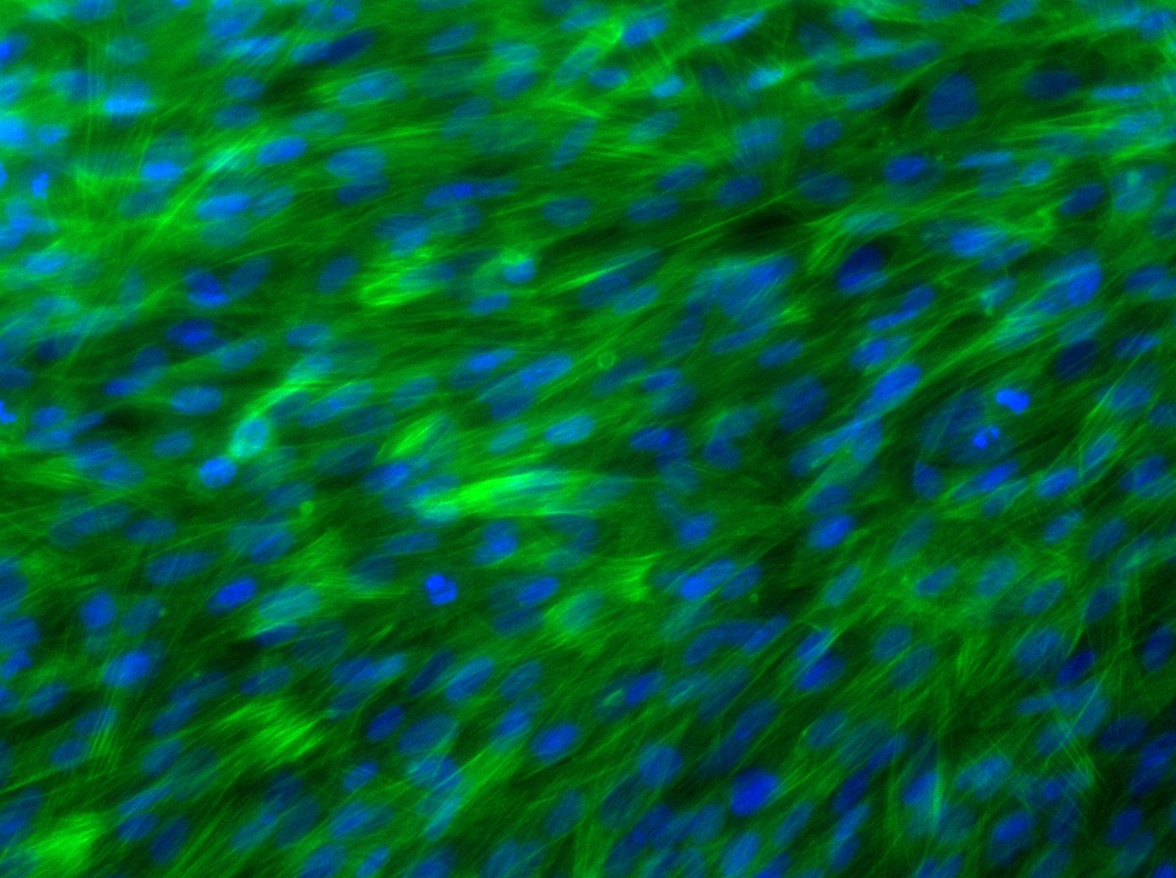
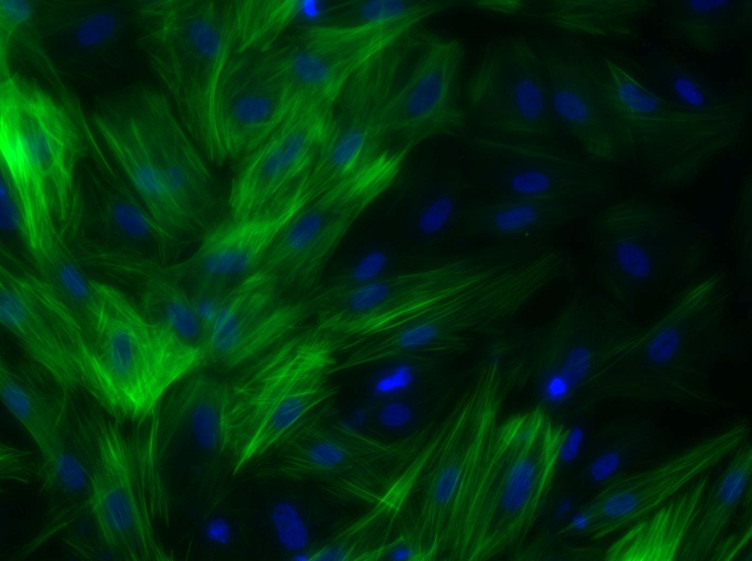
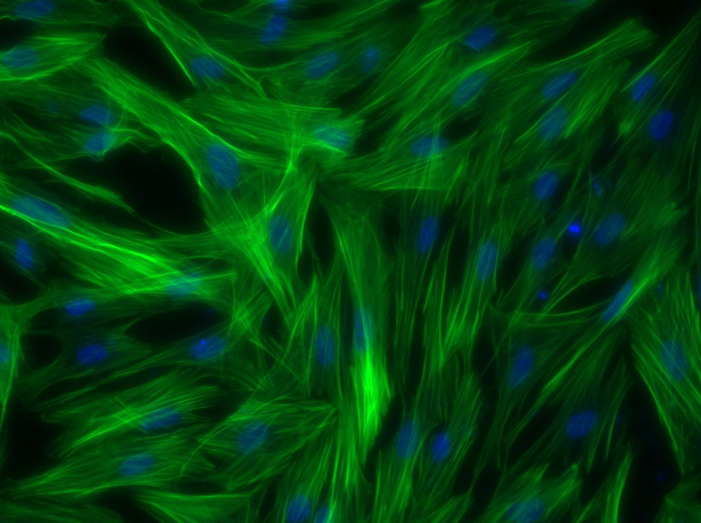
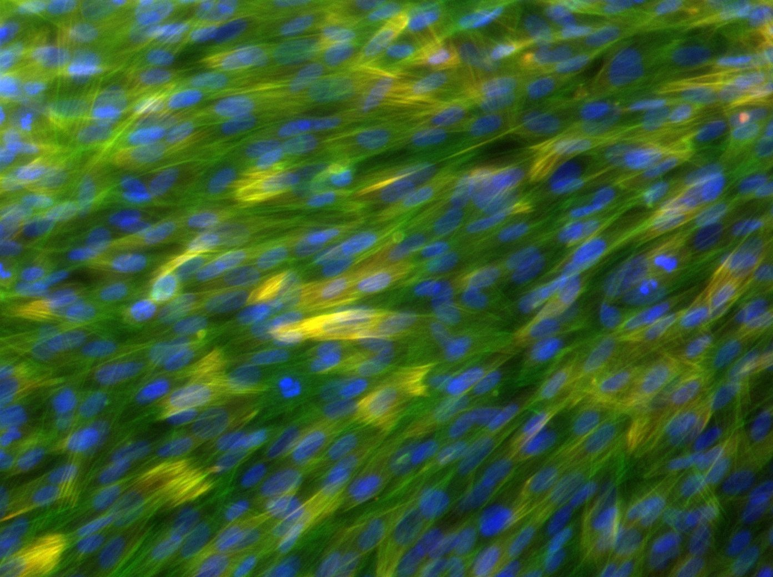
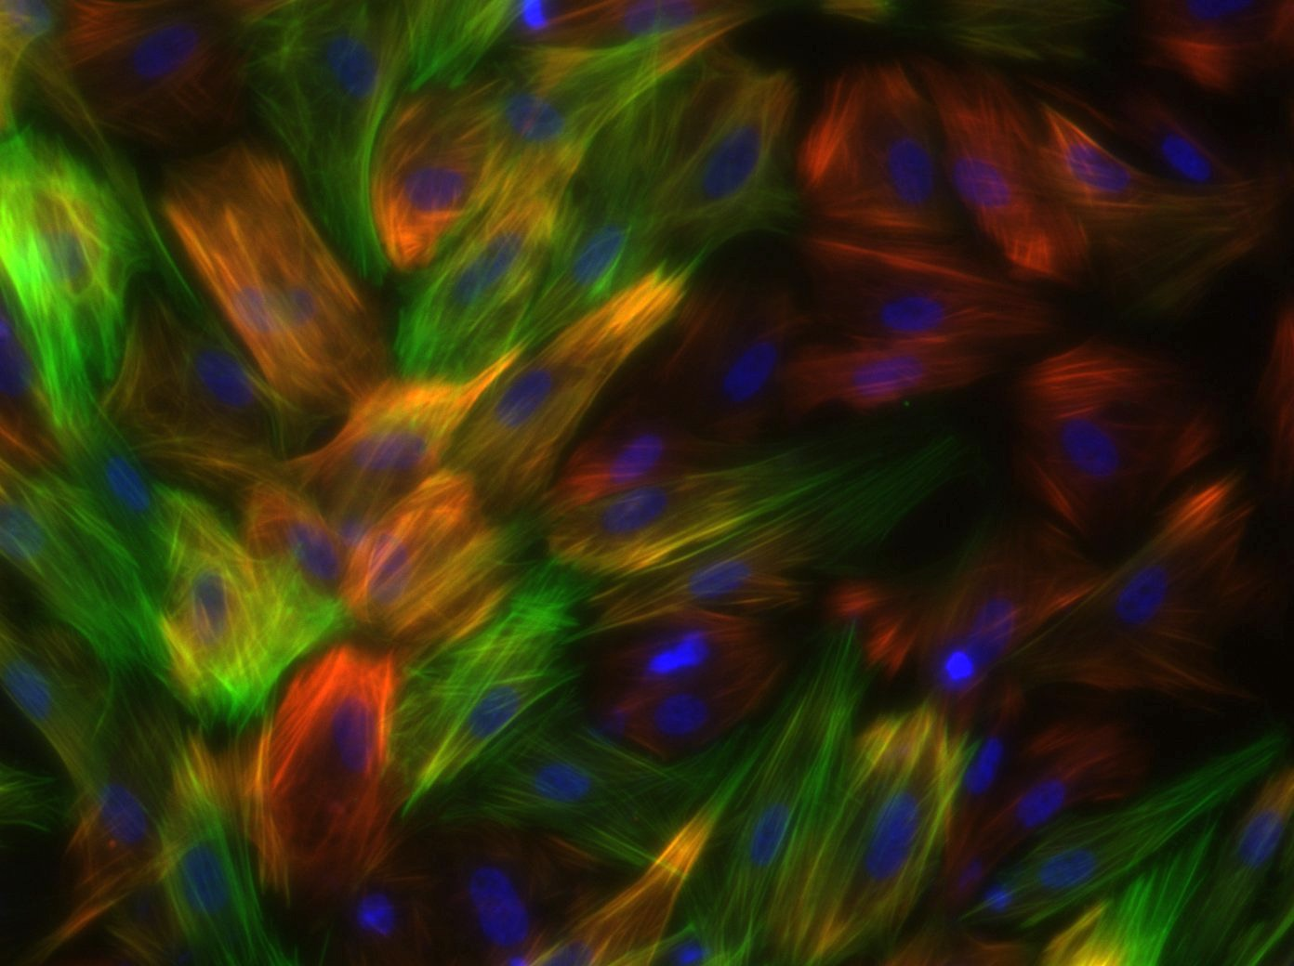
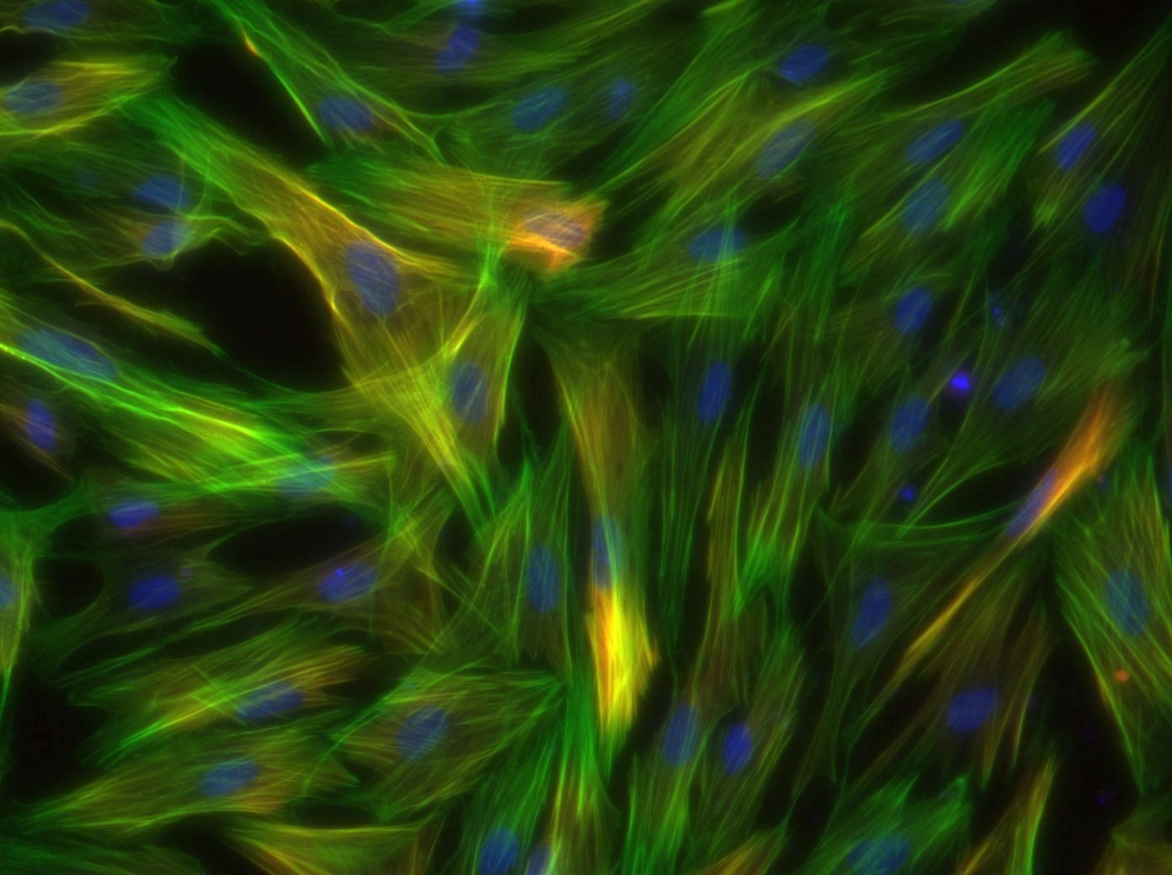
iMSC-G
iMSC-B
iMSC-T
Figure 3. Cells were stained for calponin (red, top & bottom), phalloidin (green, middle & bottom), and DAPI (blue) and imaged at 20X magnification
Figure 3. Cells were stained for calponin (red, top & bottom), phalloidin (green, middle & bottom), and DAPI (blue) and imaged at 20X magnification

Slide 6
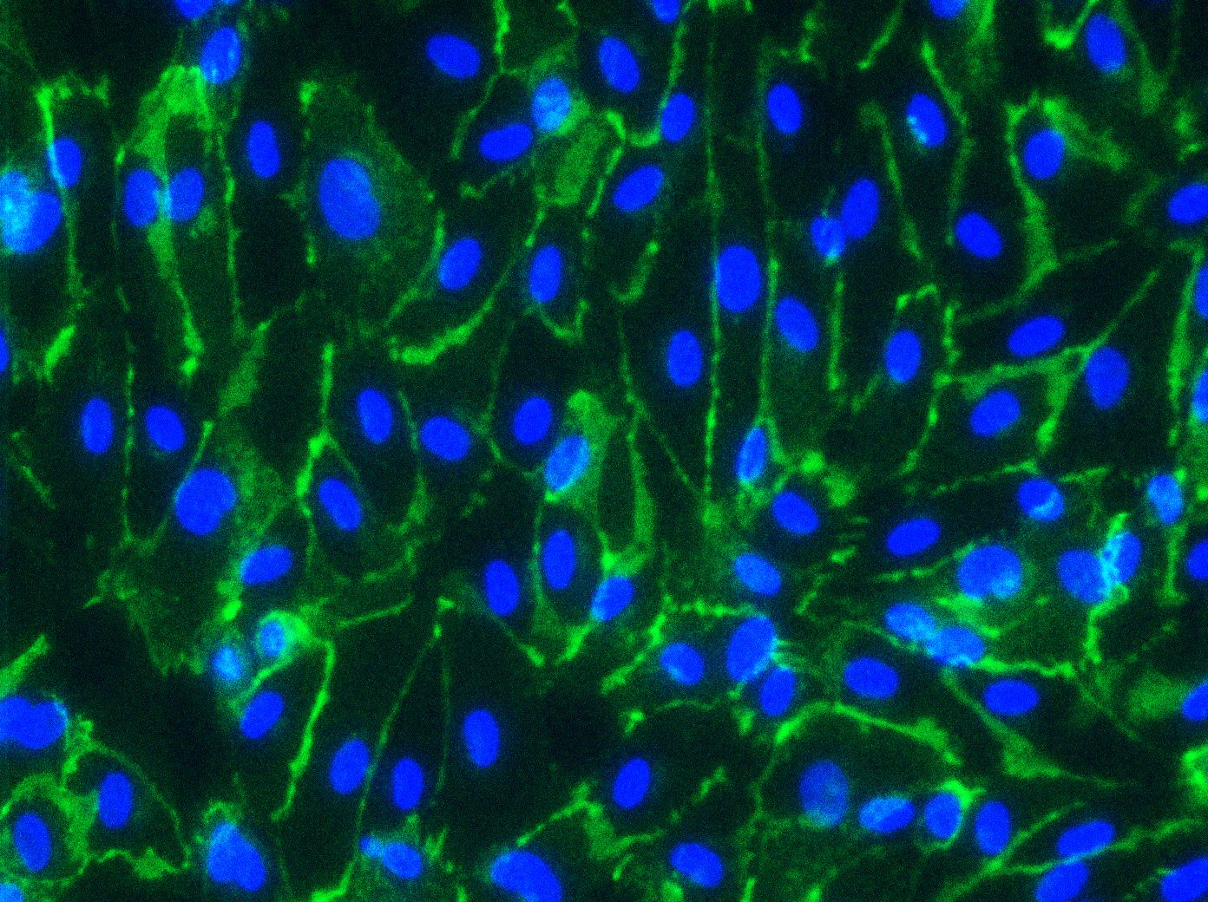
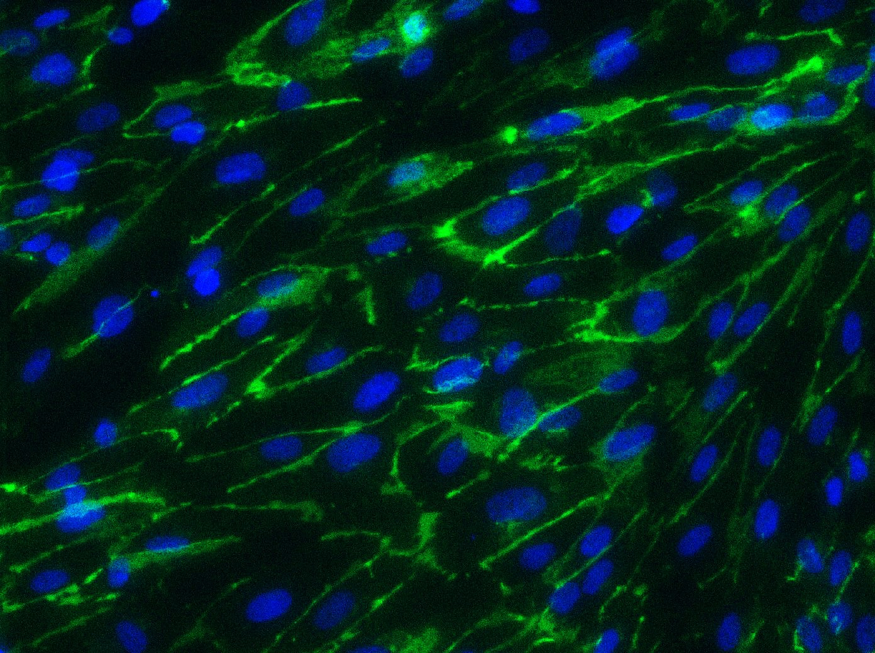
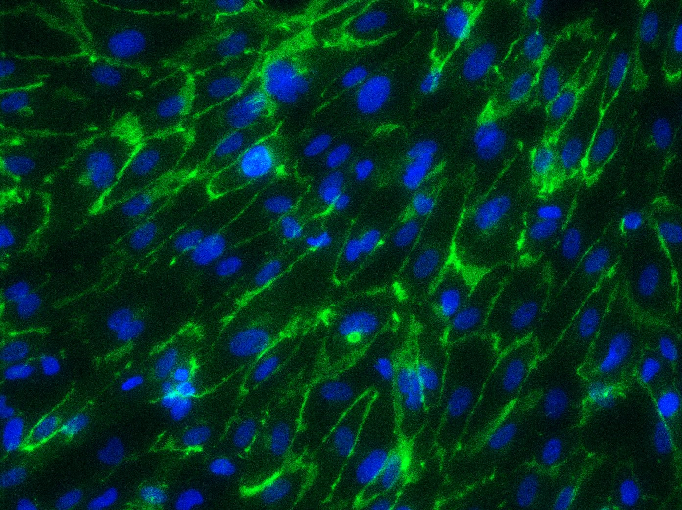
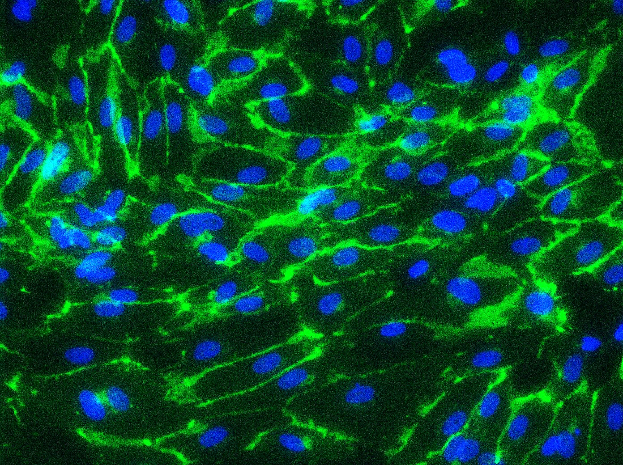
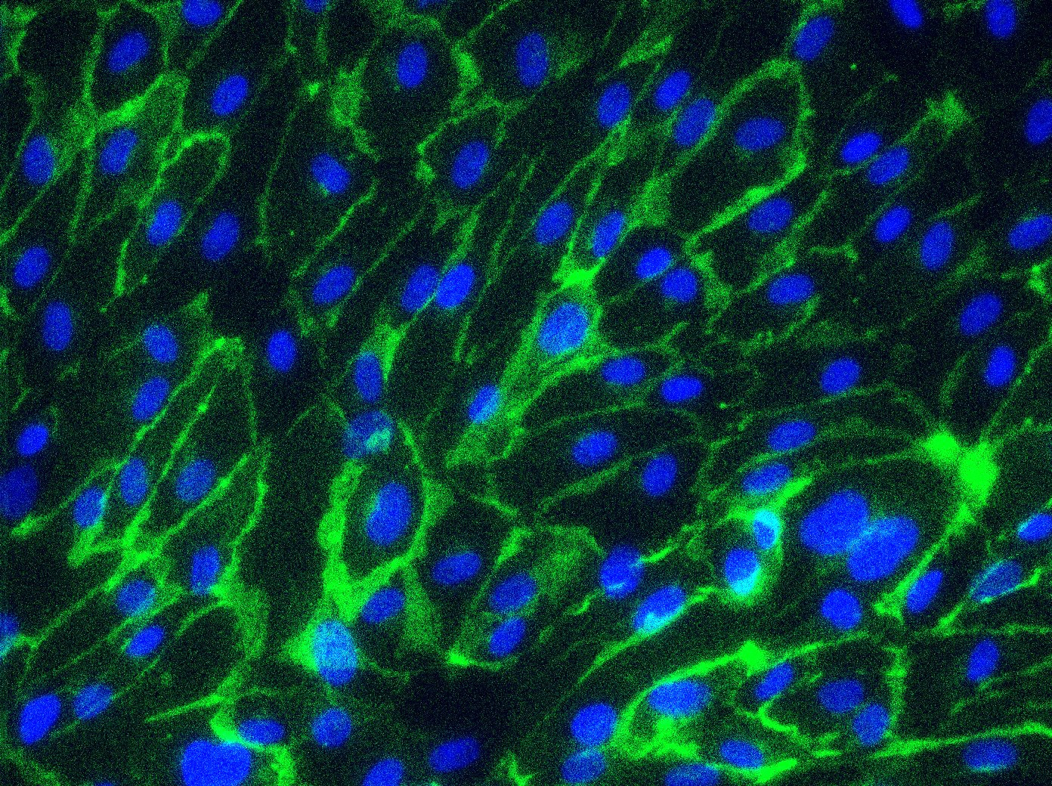
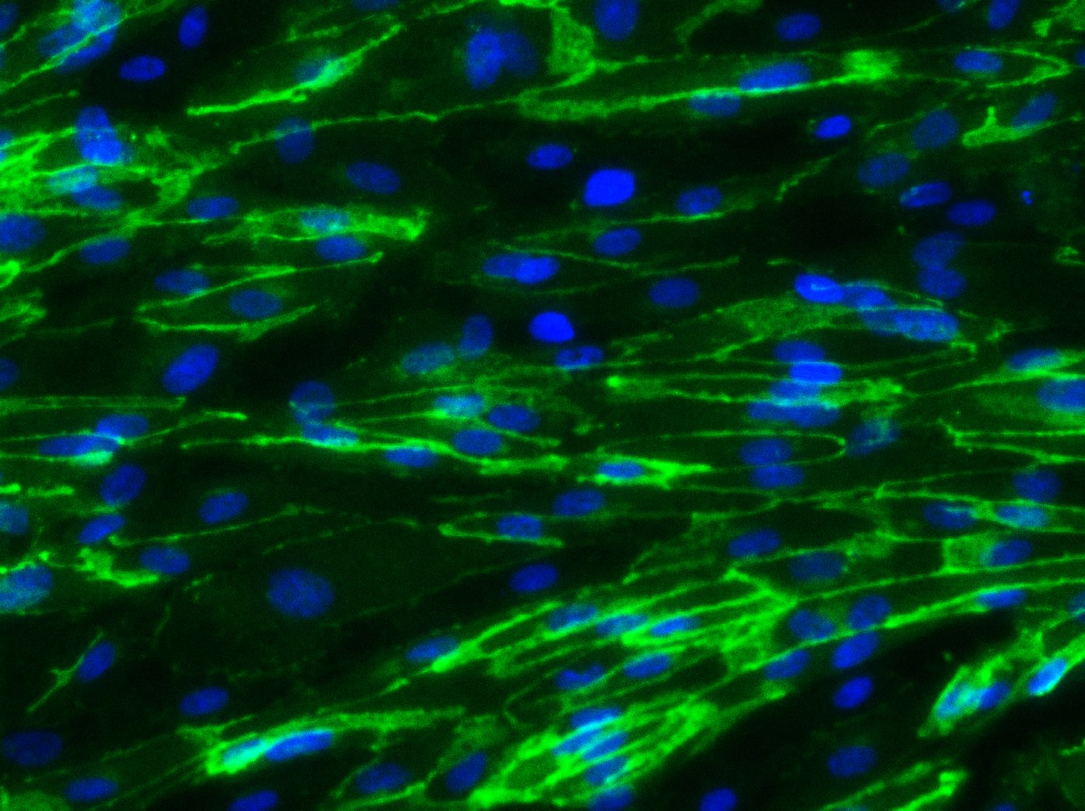
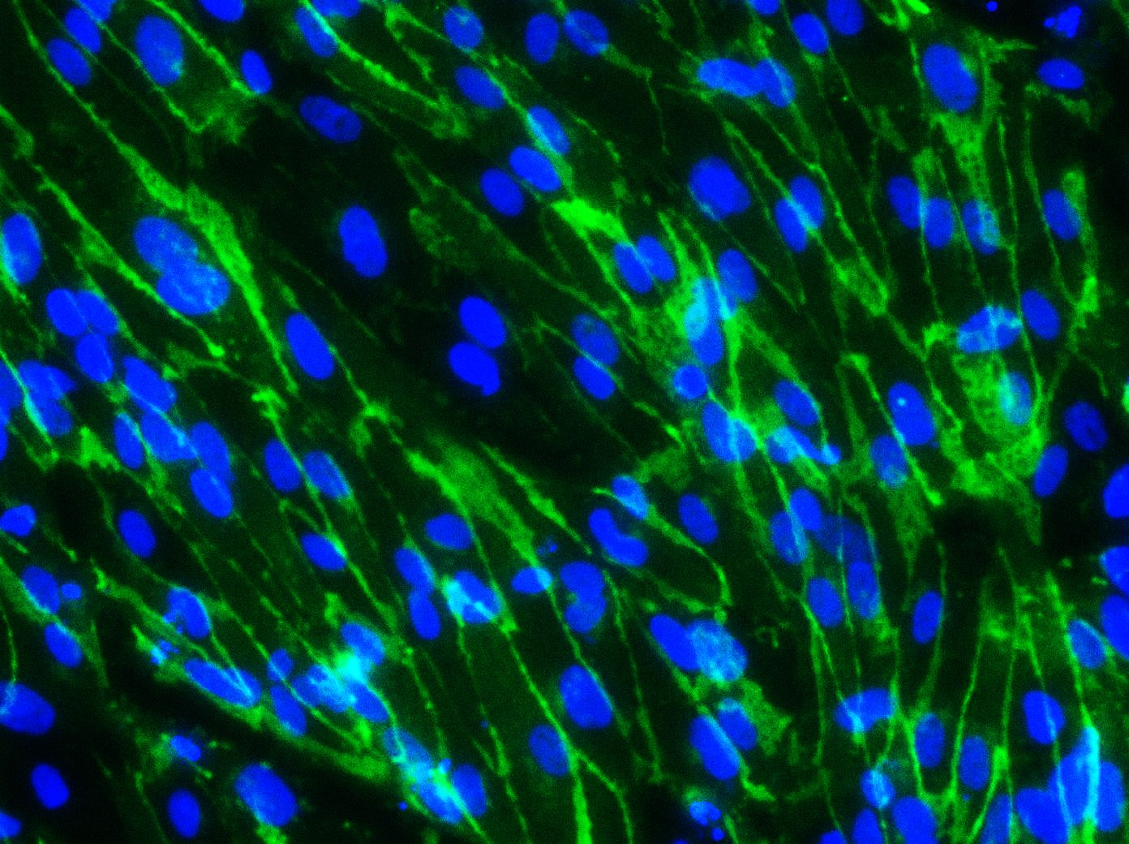






iEC-G
SMC-G-Cond
SMC-B-Cond
SMC-T-Cond
iEC
Monolayer
SMC-G/iEC Bilayer
SMC-B/iEC Bilayer
SMC-T/iEC Bilayer
DIVI D13
Notes:
Top is vecad/dapi
Middle is zo1/dapi(top control, bottom divi)
Include iEC monolayer as a control to see how it either helps or hinders
Bottom is phalloidin/dapi (top control, bottom divi)
3 separate figures

Slide 7







iEC-G
iMSC-G-Cond
iMSC-T-Cond
iEC
Monolayer
iMSC-G/iEC Bilayer
iMSC-T/iEC Bilayer

